Slide 1
Off to a Good Start: Off-Campus Living in Your First Year at Iowa
Notes:
Off to a Good Start: Off-Campus Living in Your First Year at Iowa - We know many first year or transfer students may choose to live off-campus, whether that is with friends, family, or on their own. This session, led by various staff members across campus, will include strategies for building connections and community on-campus, information on off-campus student specific resources, and suggestions on how to be a good neighbor in the Iowa City and surrounding communities.

Slide 2
What to Expect
Resources and Support
Building Community
Tenants' Rights and Responsibilities
Questions

Slide 3
Student Care and Assistance
Respond to situations and partnering to support students in need
Crisis, emergency, and “life” situations:
Hospitalization
Medical emergencies or long-term illness
Mental health concerns
Chronic conditions
Death of a family member
Natural disasters - fire, tornado, flood
Off-campus living concerns
Difficulty meeting basic needs
Unexpected events or challenges
One-on-one support, identify options, assistance accessing resources
Notes:
SCA

Slide 4
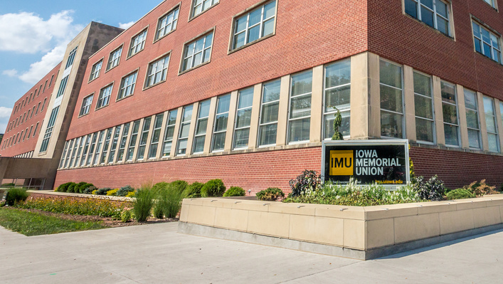
SCA: Programs & Initiatives
General Support
Student Life Emergency Fund
Support Fund for Name Changes
Safe Room
Early Intervention Team
Student Care Coordinators
Therapy Dog
Response to UI Support and Crisis Line
Liaison to Crisis Stabilization Unit, GuideLink Center
Off-Campus Student Support
Off-Campus Living Guide
Quick Guide for Responding to Distress

Slide 5
Building Community
Get Involved!
Leadership and Engagement
Engagement Advising
Student Organizations, Fraternities and Sororities, Campus Committees, Hawkeye Service Breaks
On-Campus Jobs
Handshake
Friends in Class
Group studying
Supplemental Instruction, Academic Support

Slide 6
Student Legal Services
Free legal advice & representation
CONFIDENTIAL
Real lawyers
Variety of practice areas
Tenants' Rights
Criminal Defense and Traffic Tickets
Name Change
And more
Website

Slide 7
Moving In
Lease
Pre-Move In
Moving Day
Read your lease
Understand the rules
SLS lease review
Utilities
Renters insurance
Roommate agreement
Failure to deliver possession?
Move-in checklist
Pictures/videos

Slide 8
Living in Your Rental Unit
Best Practices
Tenant Responsibilities
Landlord Responsibilities
Communicate in writing
Document everything
Renewals/lease gap
Pay your rent
Follow the rules
Notify landlord of maintenance concerns
Duty to maintain
Essential services
Access to unit

Slide 9
Off-Campus First Year & Transfer Event
Join us during On Iowa! for the Off-Campus First Year & Transfer Welcome Event!
Free Food, Prizes, and Connection!
August 22nd 4:30pm-6:30pm, IMU

Slide 10
Healthcare Power of Attorney Workshop
August 19, 20, 21 at 9:00 a.m.
Iowa Theater, 166 IMU
Registration Info Coming Soon!
Notes:
*** Add slide for SLS POA Clinic (TBD)

Slide 11
Student Care and Assistance 319.335.1162 dos-assistance@uiowa.edu dos.uiowa.edu/assistance
Student Legal Services 319.335.3276 student-legal@uiowa.edu studentlegal.uiowa.edu
Notes:
MOD
Thank you for all time and energy and effort this morning and if you need more information, here is how you can contact either of our offices.

