Slide 1
Notes:
AAC
Good morning and welcome! My name is NAME and I am TITLE of the AAC.
AS&R
and my name is NAME and I am the TITLE in Academic Support & Retention
AAC
Presentation Overview
Building off what you have heard so far, we want to spend some time with you this morning talking about academic success at Iowa. Our two offices work with and support a lot of undergraduate students every year. With all this experience, we have identified the patterns of what successful students do, and we also know the patterns of students who struggle in college. We are going to share 4 Strategies for academic success with you. Students – we hope that these suggestions will get you thinking about the behaviors and habits that will lead to your success in the next year. Families and guests – we hope that our suggestions will help you as you support your student this year.
XXX is going to start us off on Strategy 1

Slide 2
Understand Time & Expectations
Strategy 1
Notes:
AS&R
The first strategy that can help you be successful in college is to understand your time and the expectations of you as a student at Iowa.

Slide 3
What will your time look like?
Academics
Study 2 hours/week for every credit hour
Engagement
Work
Social
Balancing multiple commitments
Notes:
AS&R
As a student at Iowa, we expect you to engage in your learning, get involved, stay connected with family and friends, and make new ones and so it can be overwhelming figuring out how to spend your time. At Iowa, we have a survey called Excelling@Iowa that you will take as part of your Success at Iowa course. Through that survey, you can let us know how you are doing and folks across campus can connect with you about your transition. Up to now, we have had over 35,000 new student take that survey and we know one of the #1 concerns new students face is managing their time and commitments. We want you to remember that you are not alone and there are lots of strategies you can use to help you be successful.

Slide 4
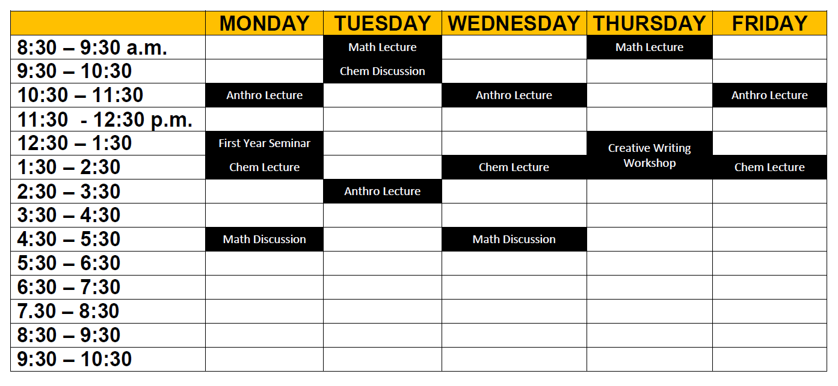
Notes:
AS&R
It is a good practice to be familiar with your schedule. You can find your schedule on MyUI and this an example of what we would consider a typical schedule of 16 credits or semester hours. At first glance, this does not seem like a lot of time in class you may wonder what will you do with all of this free time. At Iowa, you will spend less time in class and an increased expectation that you will be doing more on their own. There is typically less homework in college and more of a focus on studying. This often means fewer graded assignments. As for time management, we recommend that planning on spending about two hours outside of class for every hour in class.

Slide 5
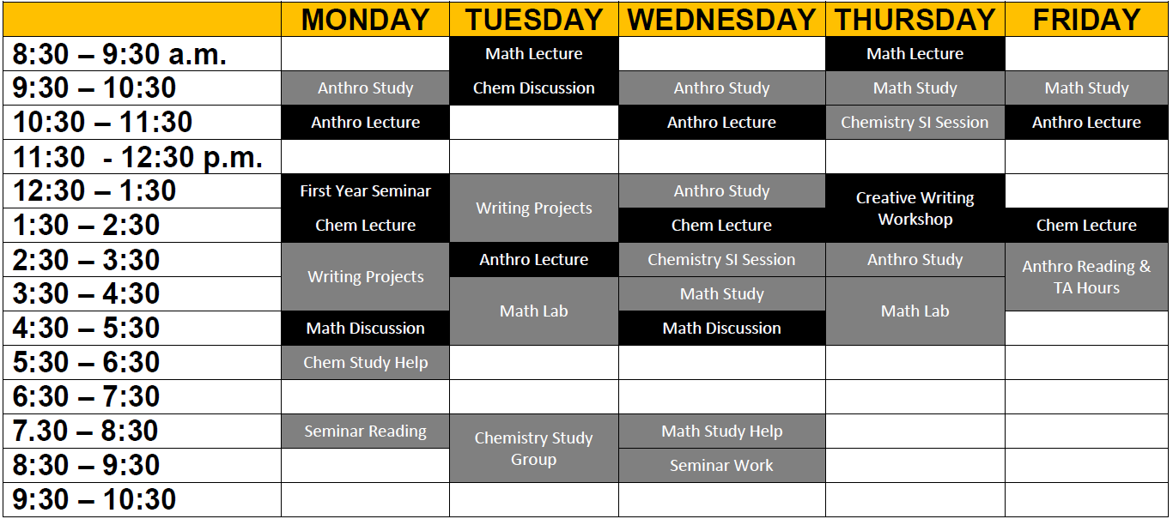
Notes:
AS&R
Now when we add in the work for the week, we can see a schedule starts to fill. It may consist of working on assignments, studying, going to campus help labs, or study groups. This, of course, doesn’t include the weekend, but it does give you an idea of how busy you may feel. While you may not be in class all day, you will be spending a lot of time on school.

Slide 6
What will your time look like?
Academics
Study 2 hours/week for every credit hour
Engagement
Work
Social
Balancing multiple commitments
Notes:
AAC
In addition to engaging in your learning both in and out of the classroom, we want you to get involved. This may mean getting an on-campus job, conducting research with a professor, or joining a club or student organization. The important piece is that you work to find balance between your academics and your involvement. As long as you’re smart about the amount of time and energy you’re putting into your co-curricular activities, getting involved during your first semester can actually help you to be more successful in the classroom because early on it allows you to set a schedule and routine, helps you to build connections with peers and create a community of support on campus. Again, the important piece is that you strategically manage your campus activities. It's not uncommon for students to want to focus on classes and no extracurriculars, and the instinct to focus on academics is great. But we would still encourage you to get involved in at least one activity because we don't want you to study all the time (you need balance), and data shows us that students who are involved are more academically successful in the long run.
We typically recommend starting out by dedicating 15-20 hours per week to involvement, at least to start, so as to ensure that you’re finding balance between your academic responsibilities and your social life.

Slide 7
Practice Foundational Academic Behaviors
Strategy 2
Notes:
AS&R
Our second strategy is to practice academic behaviors. Now there is often a misconception that students who are successful are inherently smarter, and we know that is just not true. When you were born, you didn’t know how to walk, you needed to grow, develop, and practice before you got good at it. Learning is similar, there are things that we need to do in order to be successful – however you define that for yourself. We can’t all be Beyonce and “woke up like this” – there are things that we need to do.
Even though success is dependent on the person, there is a commonality that we know about successful students, and that commonality is that success is largely contingent on a set of behaviors. Intelligence isn’t fixed or pre-determined, the more you study and practice positive academic behaviors in college, the more likely you are to be successful.

Slide 8
What strategies will help me?
Go to class
Read before class
Take good notes
Notes:
AS&R
The most basic academic behaviors a student can do are go to class, doing the reading before class, and take good notes. Statistically students who do all three of these behaviors are more academically successful and are more likely to achieve their desired GPA. Whether classes are face to face or online, these three apply and we know you can do them!
Let’s first talk about going to class. It may seem simple but let me tell you that some days when it is rainy or snowing and you are snuggled warm in bed, you are not going to want to get out of bed and attendance may not be required, it is still really important to go to class.
Now, second is read before class. If you are going to go to class, being prepared can really help you be successful. It helps prime your brain for all the information and helps create a synthesis from your readings to your lectures and discussions.
Now that you have gone to class and were prepared by doing the readings – if you are in class, you should take good notes. Now good notes doesn't mean writing everything down word for word, but instead writing down the main points and information that is shared that you can then go back and review after class or during the 2 hours of study time outside of the credit hours you are enrolled in.
Once you have these 3 things down, you can start to expanding your behaviors by things like talking with your professors, participating in class, working well in advance of the due date and using resources, which brings us to Strategy 3.

Slide 9
Stay Informed
Strategy 3
Notes:
AAC:
Strategy #3 to becoming a successful student is staying informed. Staying informed includes knowing about and understanding the tools and people available to you.

Slide 10
How do you stay informed?
MyUI
Email
ICON
Syllabus
Notes:
AAC
We will cover four tools that will help you stay informed of essential information. First, MyUI is your go-to system that has links to most everything you are going to need.

Slide 11
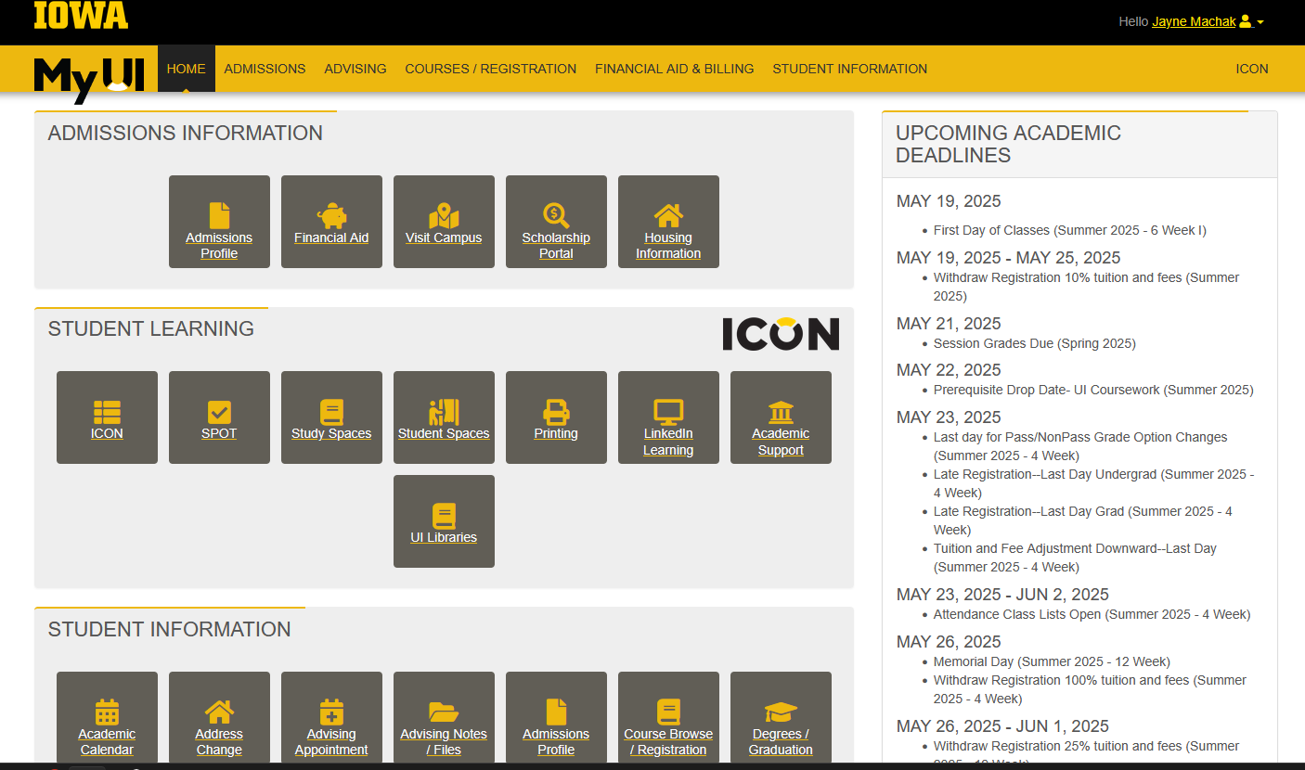
Herky Hawk,
Notes:
AAC
Here is the landing page in MyUI. You may have already familiarized yourself with a few features as you have been moving through the admissions and orientation processes, including SOAR. You will notice on the right important information about university deadlines. There will occasionally be important information specific to your record or grades. Make sure to check in here frequently.
MyUI also lets you set appointments and understand where you are in your academic journey.

Slide 12
How do you stay informed?
MyUI
Email
ICON
Syllabus
Notes:
AAC
One of the best ways to stay informed is to read your University email. Students, we know that email is likely not your preferred method of communication, but it is the official way that the University will reach out to you. The most successful students check their email daily.

Slide 13
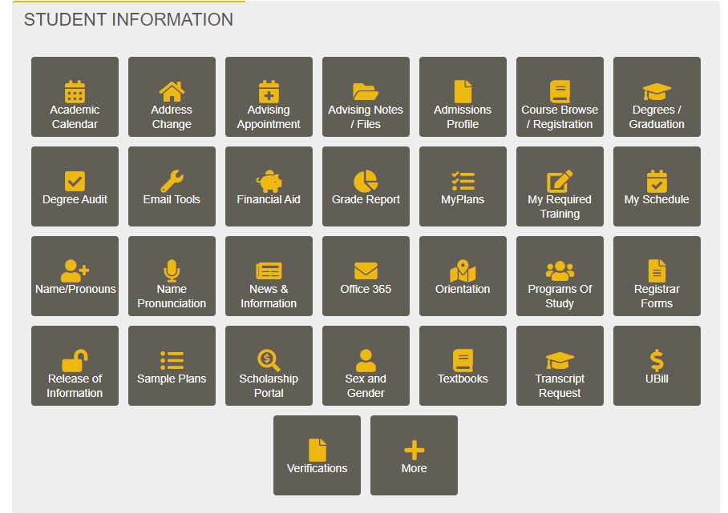
Notes:
AAC
You can navigate to your university email account several ways. When in doubt, refer to the MyUI landing page for a link to Office 365.
We especially recommend that you pay attention to names of professors, TAs and your advisor in your Inbox so you don't miss important messages. This is a really important life skill that you start building now. Your advisor could email you later this summer related to a change in your Fall schedule and that is definitely something you want to read. There are also University offices that reach out to students by email....

Slide 14
Notes:
AAC
This is an example of an email a student received from the Office of Student Financial Aid. Financial Aid is an example of a complex system with many moving parts. The Office of Student Financial Aid does a great job of communicating with students on next steps so that everything can be processed with your Financial Aid. Students who aren't checking email frequently are missing out on crucial information.

Slide 15
How do you stay informed?
Email
MyUI
ICON
Syllabus
Notes:
AS&R
From MyUI, you can also find ICON, which stands for Iowa Courses Online, and is where many of your instructors will add course information such as readings, recorded lectures, and is often where you will submit assignments.

Slide 16
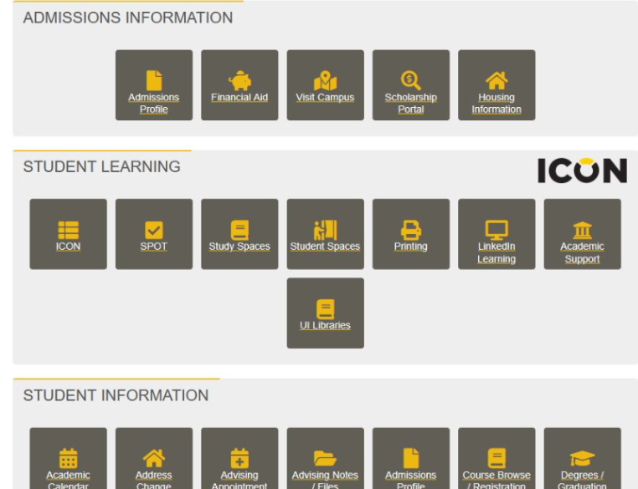
Notes:
AS&R
Here’s how you can link to ICON from MyUI. By checking ICON often, you can stay up to date on what is required for your classes.

Slide 17
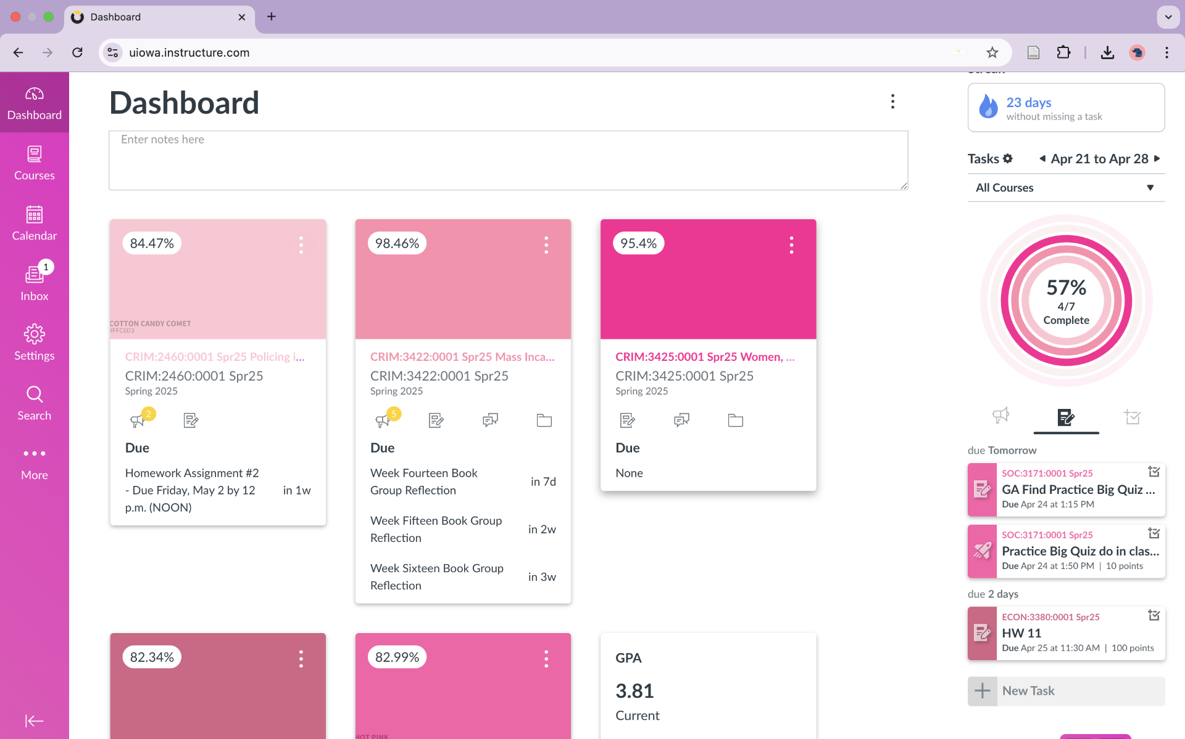
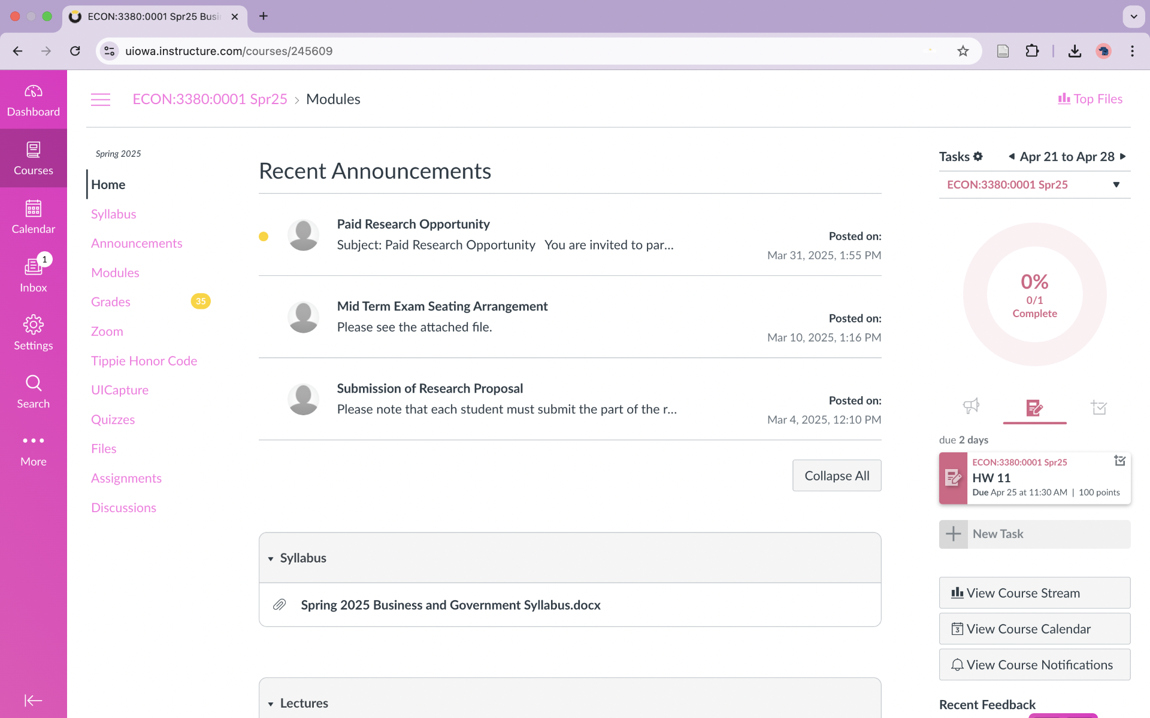
Notes:
AS&R
When you log into ICON, you will see your dashboard, which is what you're seeing on the left-hand side of the screen. Each tile represents a different course. Once click on a course, you will be taken to its homepage. You'll see an example of one course's ICON site on the right.

Slide 18
How do you stay informed?
Email
MyUI
ICON
Syllabus
Notes:
AS&R
On ICON is where you can find your Syllabus, which is a way that faculty lay out the expectations of the course.

Slide 19
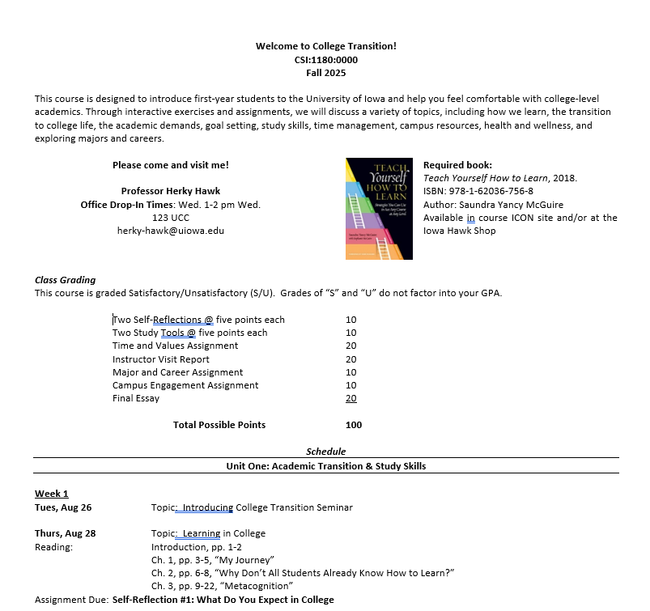
Notes:
AS&R
It contains important information such as assignments, due dates, policies, and procedures. Many faculty will review the syllabus during the first week of classes, so be sure to pay close attention! Whenever you have a questions about an assignment or due date, the first places to look are ICON and your course syllabus.

Slide 20
Utilize Resources
Strategy 4
Notes:
AS&R
Our fourth strategy is utilizing resources – there are so many opportunities for support here and we want to make sure that you know about them. There are places, websites, and people on our campus whose sole concern is supporting your academic and developmental success.

Slide 21
What do you have access to?
Places: Early & often
Physical & Virtual Options
Supplemental Instruction
Faculty Drop-In Hours
Campus Help Labs
Websites: Tutor Iowa
tutor.uiowa.edu
People: Don’t do it alone
Support Team
Notes:
AS&R
There are also a lot of places you can access. Encourage all students to utilize academic support. If there is a help lab or SI for your course, encourage all students to use it throughout the semester. Include routine reminders about academic support and engaging with the course material regularly.
At Iowa we expect students to utilize all of our campus resources. Iowa has over 20 help labs on campus to seek help from, such as the writing center, speaking center, and math lab, which parents and families - really helps in getting the most out of your tuition dollars. One specific program our office coordinates is Supplemental Instruction or SI. SI is collaborative group learning that helps with understanding & reviewing material and developing new study strategies. SI sessions are 50-minute review sessions held in this building and facilitated by another student who has already taken the class and done well. Our data shows that 1 50-minute SI session = 2-2 ½ hours of independent studying and student who regularly attend receive higher grades in their classes. Accessing academic support is something to do early and often.
Another great place you can go to is your professor’s office hours, which is a fancy title for drop-in hours. These are a great time to ask questions, get tips on how to do your best in the course, also get to know them to add them to your support team.
A great resource have is the internet – Iowa has a lot of online resources.

Slide 22
Notes:
AS&R
One major online academic resource is Tutor Iowa. The address is tutor.uiowa.edu and there is a search bar for you to search for your classes (e.g. Rhetoric, Chemistry, Math). All the free resources are listed first and then any private tutors you could hire. There are also academic tips worksheets & videos that can help with things like time management, studying for exams, and talking with professors.

Slide 23
What do you have access to?
Places: Early & often
Physical & Virtual Options
Supplemental Instruction
Faculty Drop-In Hours
Campus Help Labs
Websites: Tutor Iowa
tutor.uiowa.edu
People: Don’t do it alone
Support Team
Notes:
AAC
The most important resource you have access to is people. The most successful students don’t go it alone. They work to establish a support team that is there to help them along the way. This includes people like your RA, faculty, staff like us, and advisors. Advisors are not just here to plan classes – we really do like to talk with students about their overall experience at the university. Advisors can also be a good referral source as we connect students to the campus resources that are here to help them.

Slide 24
Academic Advising at Iowa
Academic Advising Center
College Advising
Notes:
Every entering student is assigned an academic advisor that is determined by their Program of Study. 75% of our entering students are advised at the Academic Advising Center. We advise students in declared majors in the College of Liberal Arts and Sciences, Open Majors, and students who plan to apply to one of our other colleges, such as students who are Pre-Business or Nursing Interest. We also advise pre-professional students, such as Pre-Med or Pre-Law. We advise some transfer students as well. Our advisors at the Advising Center have familiarity with all academic programs on campus and are a great resource for students who are exploring majors. Choosing a major can be a stressful thing for many students and we don't expect all of you to know exactly what you want to do right away. Advisors will help you to explore your options, learn about yourself, and utilize resources on campus to help you find a major that is a good fit.
The other 25% of our incoming students are directly admitted to one of our other colleges.

Slide 25
College Advising
College of Education
College of Engineering
College of Liberal Arts and Sciences
College of Nursing
College of Pharmacy
College of Public Health
Tippie College of Business
Notes:
AAC
The other colleges that advise incoming students are listed here on the screen. Some of you may be direct admits to one of these colleges and you met with someone from this college for your SOAR Appointment.
No matter where you are advised, you will have a person assigned to you who will be part of your support team. And if you are exploring majors or may change your major along the way, they will be there to help you make that transition.

Slide 26
Develop Your Support Team
Notes:
UAAC
Parents and families – we encourage you to ask students about their support team and who they are getting to know. If you have questions, we suggest asking your student first. If you still have questions, we welcome communication from parents and families of our students; we are happy to listen and to provide general information. We do adhere to the Family Educational Rights and Privacy Act (FERPA), which protects the privacy rights of students and limits personal information we can share with you, but that does not prevent us from talking about policies, procedures and resources to help you help your student.

Slide 27
Take-Aways for Students
Strategies to remember:
1. Understand time and expectations
2. Practice foundational academic behaviors
3. Stay informed
4. Utilize resources
Notes:
ASR
As we wrap up--the first day of classes will be here before you know it. You will have opportunities to discuss strategies for academic success and your college transition as you start this exciting journey. In general, we'd recommend that you think about how you will execute the broader strategies we've discussed today. Most importantly, remember that you are never alone in navigating your academic journey at Iowa. Advisors in the AAC, the caring staff in support offices like AS&R, and your instructors are all eager to guide you toward academic success, however you define it. (check time to expand or cut)

Slide 28
Take-Aways for Families and Guests
Ask questions:
How are you managing your time?
What academic behaviors are working?
What academic behaviors aren't working? What changes will you make?
How often are you checking your email?
What campus resources have you used so far?
Who is part of your support team?
Notes:
AAC
The strategies we shared today are geared toward students to help transition to college life but we know parents and families—all of you in the audience here with your student--are an important part of a student's support team as well. As your student transitions to college, parents and families can be partners in achieving academic success. So for all the support people in the audience, here are some questions you can ask your student when you talk to them in fall.
What time management strategies are working for you?
What academic behaviors are working?
What academic behaviors are you proud of so far?
Are you checking your university email?
What campus resources have you used so far?
Who is part of your support team?

Slide 29
Office of Student Learning 319.467.1561 ui-learning@uiowa.edu tutor.uiowa.edu
Academic Advising Center 319.353.5700 advising-center@uiowa.edu advisingcenter.uiowa.edu
Notes:
AS&R
Thank you for all time and energy and effort this morning and if you need more information, here is how you can contact either of our offices. Both of us will be available in the back of the room during the break if

Slide 30
Notes:
AS&R
On Iowa! Go Hawks!

