Slide 1
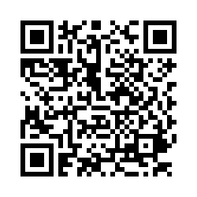
Study Abroad at Iowa
PARENT PRESENTATION
Orientation questions?
Orientation 2025

Slide 2

Study Abroad at Iowa
Credit-bearing international course work
  Credit counts towards the UI degree
  Students fulfill requirements for their major, minor, certificate, general education, experiential learning, and general electives
200+ study abroad programs, including global internships
Located in over 45 countries
Summer, semester, winter, and academic year programs
In 2023-2024, 986 undergraduate students studied abroad
23% more likely to graduate in four years
Notes:
Here is UI Study Abroad…
Courses taken abroad count towards students’ degree!
Fulfill requirements for Major, Minor, Cert., Gen Eds, and/or general electives.
We have over 200 programs worldwide in over 45 countries and this includes global Internships.
The first full year after the global pandemic, Academic Year 2021-2022, UI had 425 undergraduate students study abroad which is 61% of the academic year prior to the pandemic. (AY 2018-2019).
According to the statistics UI has been keeping since 2010, undergraduate students who study abroad are 23% more likely to graduate in 4 years than those who did NOT study abroad.

Slide 3

Benefits of Study Abroad
Academic expansion
  Take classes that are not offered at UI
  New perspectives
Personal growth
  Maturity
  Self-confidence
  Enhanced awareness of global interconnectedness
Professional development
  Gain experience employers are seeking
    Decision making
    Problem solving
    Adaptability
    Resilience
Notes:
There are many benefits to studying abroad.
Students can take coursework not offered at UI and have the opportunity to look at their major from a global perspective
When studying abroad students experience personal growth. The number one response we receive from students who have returned from studying abroad is how they feel more self-confident and self-reliant.
Study Abroad also enhances students’ awareness of global interconnectedness and they learn how to collaborate internationally
By participating in a study abroad program students gain the experience and skills that employers are looking for such as;
Decision-making,
Problem-solving,
working in diverse groups
and communication skills.

Slide 4

Cost of Study Abroad
Factors that affect cost
  Program length/duration
  Program type (faculty-led, affiliated provider, exchange)
  Resident vs. non-resident tuition status at UI
  Number of credits earned
  Cost of living in host city/country
  Travel expenses

Slide 5

Cost of Study Abroad
Costs billed to U-Bill for sponsored programs
  Program fee (for faculty-led or affiliated provider programs) or UI tuition (for exchanges)
  Study abroad admin fee
  CISI insurance
Semester programs
  Residents: More expensive than semester in Iowa City
  Non-residents: Range from less expensive to more expensive than semester in Iowa City
Summer, winter, and spring break programs
  Less expensive than semester programs
  Less financial aid and fewer scholarships are available

Slide 6

Study Abroad Funding
529 funds
Federal financial aid (Pell Grant and federal loans)
UI scholarships and grants
UI colleges’ scholarships and grants
Study Abroad scholarships and grants
  Merit/GPA
  Need-based grant
  Global Access Ambassador Scholarship
External scholarships
  Benjamin A. Gilman Scholarship
  Fund for Education Abroad
Notes:
There are many factors that go into calculating the cost of study abroad. These include when students go abroad (Summer/Winter or Semester), what type of program they choose, and whether they are paying in-state tuition or out-of-state tuition.
(Don’t be fooled into thinking that going for a shorter period means that it will be cheaper!)
UI student have funding opportunities for Studying abroad.
They can use any federal financial aid that they receive for studying abroad. In many cases your UI tuition scholarships and grants can be used for studying abroad as well.
Many UI colleges offer their own scholarships specifically for studying aboard.
Additionally, the Study Abroad office awards about $600,000 in scholarships and grants each year.
We have scholarships and grants based on Merit/GPA, based on Need and based on Diversity. We also help students with external scholarships such as the Benjamin A. Gilman scholarship and the Fund for Education Abroad that is awarded by the US State Dept.

Slide 7

Health, Safety, and Security
Dedicated staff for health, safety and security
CISI mandatory insurance coverage
UI-sponsored programs are vetted and monitored by our office
Online pre-departure orientation course
Synchronous pre-departure orientation session with Study Abroad Advisor
24/7 emergency contact if help is needed
Notes:
We have a Sr. Associate Director in Study Abroad that is wholly dedicated to Health, Safety and Security.
She is tied in with a private security monitoring company and has connections with the government through the Overseas Security Advisory Council.
The Iowa Board of Regents mandates that all those traveling abroad must be enrolled in CISI (Cultural Insurance Services International) insurance.
Covers: Medical Expenses, Mental Health, Prescription drugs, Emergency Medical Evacuation, Security Evacuation (Natural disaster/political unrest)
They have a 24-7 Assistance Team
All students complete a mandatory pre-departure Orientation course online and have Pre-departure Orientations with their Study Abroad Advisors.

Slide 8



Family Support
Balancing support and independence
  Decision making
  Planning and goal-setting
  Discussing finances and budgeting
  Talking about health and safety
  Communication while abroad
We are your partners!
Notes:
It is a balancing act between support and independence – too much challenge leads to paralysis and non-action, too much support leads to complacency and lack of growth.
Remember that allowing students to make decisions about studying abroad will help them learn to make decisions while they are abroad.
Students should be conscious of the reasons why they are studying abroad – it helps to even write goals down
Health & safety – talk about this with your student.
Support while abroad
Students often call when there’s a problem, then don’t call when there’s a resolution. Don’t panic!
Study abroad can be an emotional rollercoaster
What are your goals – if any – for your student?
Learn to manage money?
Become more independent?
Earn credit for their major?
We are here to ensure that your student has a fulfilling and successful study abroad experience. We all had wonderful experiences and that is why we do what we do!

Slide 9



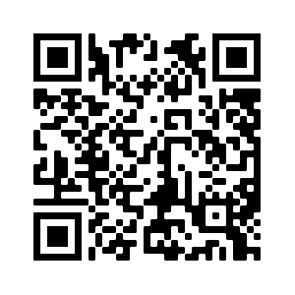
Getting Started
Complete Discover Study Abroad
  Students learn the basics and how to get started
  Offered once a week via Zoom and online anytime via ICON
  Upon completion, students receive instructions for scheduling appointment with Study Abroad Advisor
Talk with academic advisor
  Let them know you are interested in studying/interning abroad
Get a passport in our office
Attend the Study Abroad Fair - September 16
Research programs on our website: international.uiowa.edu/study-abroad
Notes:
Here is how your student gets started.
DSA – QR Code is to our First Steps web page
Talk with Academic Advisor
Get their passport in our office
Attend the Study Abroad Fair
Check out our website.

Slide 10
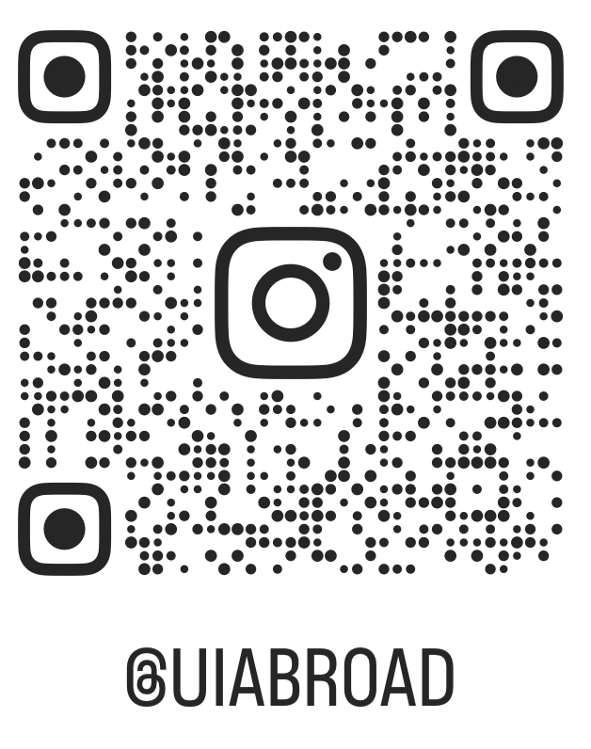



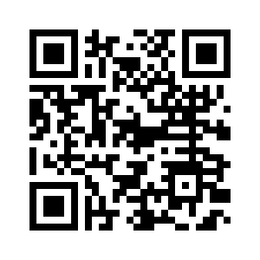

Stay in Touch
Follow us online:
  1111 University Capitol Centre
  international.uiowa.edu/study-abroad
  study-abroad@uiowa.edu
  1-319-335-0353
University of Iowa International Programs - FACEBOOK

Slide 11

QUESTIONS?

Slide 12
Thank you
international.uiowa.edu/study-abroad

Slide 13
Closing Slide Header

