Slide 1



POMERANTZ CAREER CENTER
Connecting students to career possibilities
Notes:
Welcome & Introductions (have OL handout brochures)
Our office is located on the 3rd floor of the Pomeranz Center (the same building that houses the Admissions Visitors Center if you’ve been to campus)
This session will provide an overview on the variety of ways we assist and serve students
Questions at the end

Slide 2
POP QUIZ!
According to the National Association of Colleges & Employers, what are the top 3 skills employers seek on
an entry-level resume?
Problem-solving skills
Teamwork skills
Communication skills (written)
Notes:
To get you thinking a little more about career topics…(ask audience to shout out guesses)
You’ll notice that these skills are not tied to a particular major. These skills are considered transferable skills – skills that are learned in one environment that easily transfer to other settings
All employers, regardless of industry, want employees with transferable skills. Other examples include leadership, interpersonal, and communication skills
Students gain transferable skills by participating with student organizations, volunteering in the community, working at a part-time job or having an internship
The Career Center can assist students in locating these opportunities for building their resume and developing their skill set

Slide 3


WHO WE SERVE
      College of Liberal Arts and Sciences
      Tippie College of Business
      College of Education
      College of Nursing
      College of Public Health
Notes:
Who we serve
We assist almost all undergraduate majors
The College of Engineering offers their own Career Services office (next slide)
We’re not just for seniors – we work with all class years
We encourage students to visit us early and often to discuss current plans and outline next steps
When students visit us early, they have time to take advantage of all that Iowa offers in terms of getting involved, gaining experience, and building their skill set/resume
Students can schedule an appointment to meet with a Career Coach through MyUI
Visit us early & often!
Unlike academic advising during a student’s first year, career advising is not mandatory so it’s vital that students connect with us to get the help that they need

Slide 4

ENGINEERING
CAREER SERVICES
3612 Seamans Center
Notes:
(No need to go into detail here – just mention that they serve Engineering students and this is where their office is located)

Slide 5

CAREER COACHING
Notes:
Our Career Coaches assist students by helping them navigate their path at Iowa and beyond
Career development is a verb – you have to take action to make progress! Sometimes it’s a process of trial and error, and it’s okay for plans to change
New students, especially, benefit from the exploration stage - examining their interests, abilities, and values helps students make a more informed choice regarding selecting a major/career path
If students are struggling to define their interests, we encourage taking a career assessment which will help define their interests and provide majors and occupations that might be potential fits
Or they might be looking to explore career fields through job shadows and volunteering, and we can help them find opportunities
As students get older, we certainly can help them prepare their resume and cover letter and assist them with locating internships, full-time jobs or moving on to graduate school
We also continue to work with recent alumni for one year past their graduation date

Slide 6
YOUSCIENCE CAREER ASSESSMENT
Notes:
As just mentioned, we recommend taking a career assessment if students are open majors or having difficulty defining their career interests and want to learn how various occupations align with who they are. One assessment we highly recommend is called YouScience.
YouScience is an online assessment that consists of a series of “brain game” exercises that measure aptitudes in doing certain tasks
It also identifies career interests to then provide occupations that match both interests AND abilities – two factors that are vital for career fit
YouScience is probably unlike career assessments that students might have taken in high school which typically only identify interests
Students can take YouScience for FREE; they can complete it this summer if they wish or at any point during their time at Iowa
To take YouScience, students can search for it on the Career Center website and sign up with their uiowa email address

Slide 7










CAREER COMMUNITIES
Arts, Media & Entertainment
Business, Entrepreneurship & Leadership
Data & Information Technology
Education
*Engineering
Environment & Sustainability
Health & Wellness
Helping & Counseling
Law &
Public Service
Science Research
Notes:
We offer a career community model for advising so students can meet with a Career Coach based on their career interests
Our career communities are organized by career fields and industries and are inclusive of different locations (i.e., local, regional, national and international work settings)
Advising by career interest allows us to expand the conversation from “What can I do with my major?” to really encouraging students to think about their own specific skills and interests
We want students to be able to answer, “What work environments and job duties interest me?” and “What experiences do I need to develop my skill set?”
When students consider these questions, we know they make a more informed occupational choice that fits who they are
For students who are open majors or examining other interests, we also offer an Open Major option
Or if students have multiple interests, they may meet with coaches in more than one career community

Slide 8

Notes:
While we encourage students to meet with a Career Coach, we realize that students may be thinking about their career development outside the 8-5 business day
My Career Path is a completely online program that allows for an easy and non-intimidating way for students to start making career progress on their schedule
Based on career interests and plans, students receive personalized suggestions regarding career activities, fairs and events, and other career to-do’s to get started with
New students can begin My Career Path at any point!

Slide 9


ACADEMIC COURSES
Notes:
The Career Center offers several classes for academic credit that allow students to focus on their career, leadership, and professional development
A few offerings for new students include (feel free to take a pic):
Major & Career Exploration class:
7 week, 1 s.h. course
Great fit for students who are open majors or for students who have a major in mind and are now wondering about career possibilities
Students take the YouScience career assessment and explore occupations through employer panels and informational interviews
Online & in-person sections available
Career Leadership Academy:
Two semester program (Part 1 & Part 2), 3 s.h. each semester
CLA allows students to strengthen their employee-readiness skills by:
Examining their personal leadership style
Practicing working in a team setting
Learning how to lead within the community
Preparing for the professional world
Online & in-person sections available

Slide 10
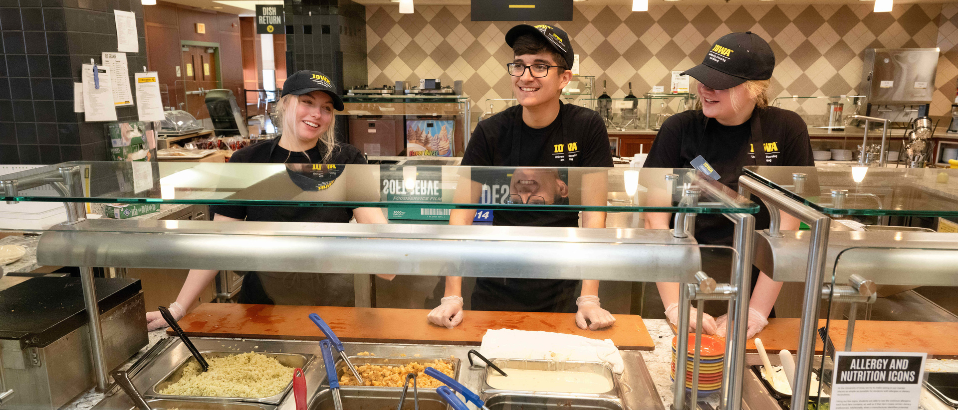

Notes:
Handshake is our online recruiting system where students can search for a variety of positions
Our employer partners utilize Handshake to post full-time jobs and internships
Handshake is also where students can find part-time jobs in the community and on campus, including work study positions
Handshake is free for students and incoming students can access their account now
If your student is interested in working on campus this fall (or spring), please attend the Student Employment session this afternoon at 2:05 or 2:40 to learn more – we will have a Student Employment job fair at the start of the semester on Wed., August 27.

Slide 11
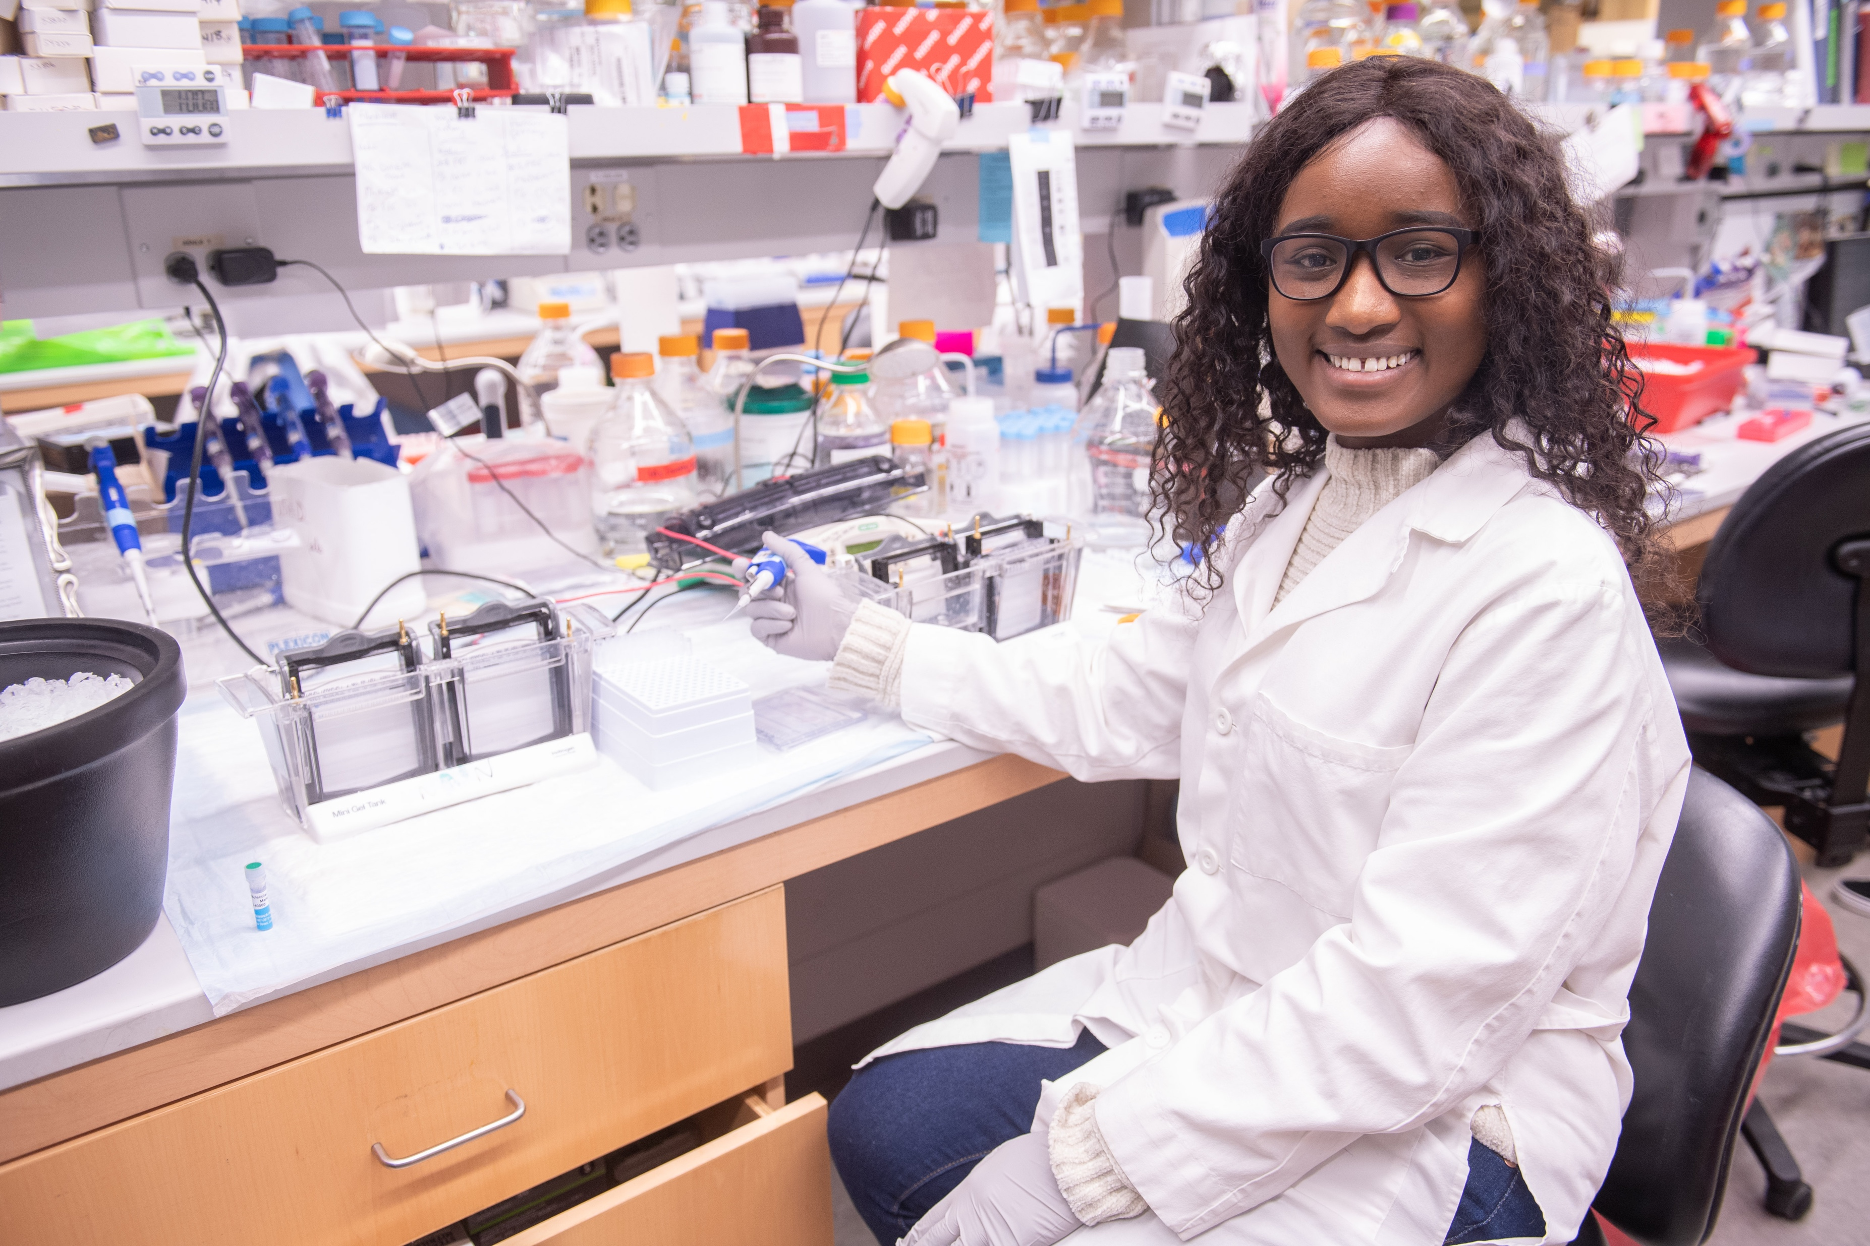
INTERNSHIPS
Notes:
Internships have become a crucial element for a student’s career development. More and more employers are looking to see that students have completed at least one internship (or other practical work experience like research or field work) before starting a full-time position. An internship allows students to:
Apply classroom learning to a real-world environment
Learn industry structure and receive in-depth knowledge of a specific field and related occupations
Develop technical and soft skills while gaining confidence in their abilities
Build their professional network
Gain valuable experience and accomplishments to add to their resume
We receive internship listings for all majors with a variety of companies and industries across the country and internationally – some internships are paid, some are unpaid; some internships are on-site, some are remote
Students can complete an internship during the fall, spring, or summer – most internships are available for sophomores and above
Students can utilize Handshake to search for internships and meet with a Career Coach to discuss other resources for locating opportunities

Slide 12

CONNECTING WITH EMPLOYERS
Notes:
Nearly 600 employers actively recruit on campus, and we provide several ways for students to connect with companies throughout the school year:
Career Fairs – We offer two all majors career fairs each year, along with several niche events like our Actuarial Science, Insurance & Risk Management career fair, our Science, Health & Sustainability career fair, and our Education fair
Career Treks – Our career treks are opportunities to visit local and regional employers to learn more about company operations and positions available, and network with professional staff. This past school year, we offered treks focused on Science & Nature in Minneapolis, Business & IT in Des Moines, Writing & Publishing in Chicago, Forensics & Criminology in St. Louis, Social Impact in Kansas City, and Technology & Innovation in Madison
On-campus Interviews & Mock Interviews – Companies utilize the Career Center space for on-campus interviews as they search for the best students to fulfill their internship and full-time positions. Recruiters will also volunteer their time to help students with their interview skills through our mock interview program
Additionally, Handshake provides virtual information sessions and panels that allow our students to connect and interact with organizations across the country

Slide 13












EMPLOYER PARTNERS
Notes:
The company logos you see here represent just a small sampling of the employers we work with – we have partnerships with a variety of companies across the country – from large and mid-size corporations to small non-profits
Our Employer Relations team works hard to maintain our employer relationships and create new employer partnerships. Our staff travel to locations around the US to visit with companies to tell them why our students are so exceptional and why they should be recruiting at Iowa
Parents - if you work for an organization that is not currently recruiting at Iowa, but interested in forming a partnership, please let us know!

Slide 14
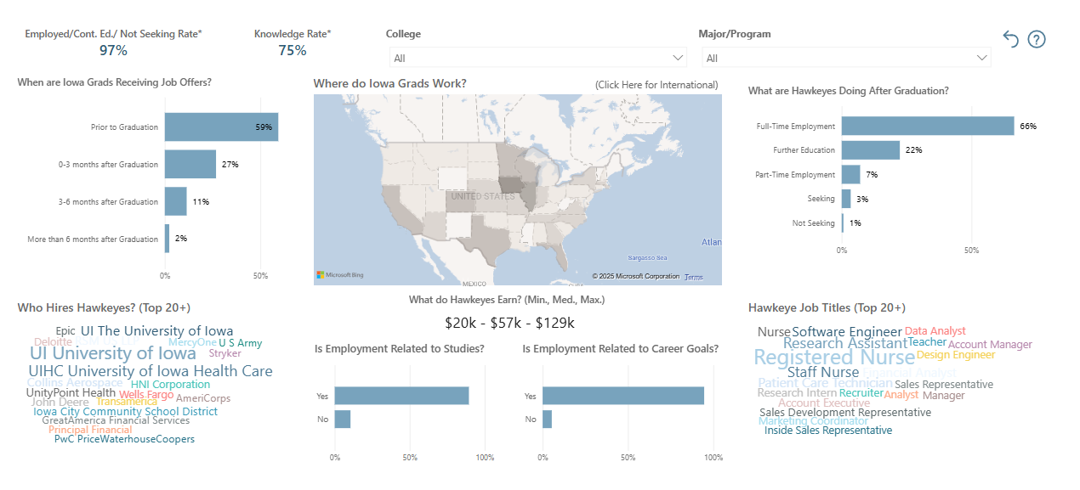
WHERE HAWKEYES WORK
Notes:
If you’re wondering about placement and employment data, we do have outcome information available on the Career Center website
You can view our interactive employment dashboard that will allow you to learn more about where Hawkeyes go after graduation
You can search by major and see common job titles, top places of employment, geographic locations, and salary information
This information is gathered from our First Destination Survey – a survey conducted at graduation and again at 6 months past graduation
Our placement rates are historically over 90%

Slide 15

Notes:
So if you don’t want your student to land here after graduation, encourage them to utilize our services!

Slide 16




TOP 10 WAYS YOU CAN HELP
Encourage a visit with a Career Coach (schedule on MyUI)
Observe a strength? Let your student know!
Support major & career exploration
Suggest taking the YouScience career assessment
Advocate for campus & community involvement
Check our website & social media channels to promote our events
Tell your student about your own job & responsibilities
Okay, so your job isn’t ‘cool’ – what about your colleagues or friends?
Suggest a Career Center class or My Career Path
Encourage internships & other experiential education opportunities
CONTACT US!
Phone: 319-335-1023 Email: careercenter@uiowa.edu Web: careers.uiowa.edu
UI Career Center Pomerantz Career Center UI Career Center
Notes:
Here are ways you can help your student prepare for career success…and prevent couch surfing
Suggest to the audience that they take a picture of this
Students can meet with a Career Coach this summer if they wish – we offer phone, Zoom, and in-person appointments. Schedule on MyUI or call our office if you need help! This presentation can also be found on the Orientation YouTube page as a recorded webinar if you would like to view with your student
Questions?
Thank you for your time and attention today!

