Slide 1
Student Engagement and Belonging
Fraternity and Sorority Life
Leadership, Service, and Civic Engagement
Multicultural and International Student Support and Engagement
Student Engagement and Campus Programs

Slide 2
Leadership and Engagement
Leadership and Engagement is housed within the Office of the Dean of Students at the University of Iowa. Our programs help students develop lifelong leadership skills, offer incredible experiential service learning, and provides civic engagement opportunities to students both on and off-campus. Leadership and Engagement is comprised of four focus areas: Fraternity and Sorority Life (FSL), Leadership, Service, and Civic Engagement (LSCE), Multicultural and International Student Support and Engagement (MISSE), and Student Engagement and Campus Programs (SECP).
We are committed to helping students develop skills and experiences that will benefit them in their roles, in various peer groups, and well into the future.
Notes:
This means that employers are expecting that student leaders have development skills and abilities that set them apart from other candidates who may not have held a leadership role. We are implementing these Student Leadership Competencies to ensure this expectation is met and each of our student leaders has the opportunity to develop themselves and prepare them for their future career field. We want them to be the most successful and effective student leaders possible and we believe that the intentional use of the Student Leadership Competencies will help.

Slide 3
Fraternity and Sorority Life Belong, Serve, Lead, Thrive, Succeed
Fraternity and Sorority Life staff work to further the bond within the Fraternity and Sorority Community and support the organizations within.
Joining Requirements
There are 4 Councils made up of over 40 fraternity and sorority organizations.
We promote the ideals of brotherhood, sisterhood, and siblinghood.
Membership in a fraternity or sorority is predicated on a lifelong commitment to leadership, scholarship, service, and community. As higher education has changed and shifted so has the experience of fraternity and sorority members.

Slide 4
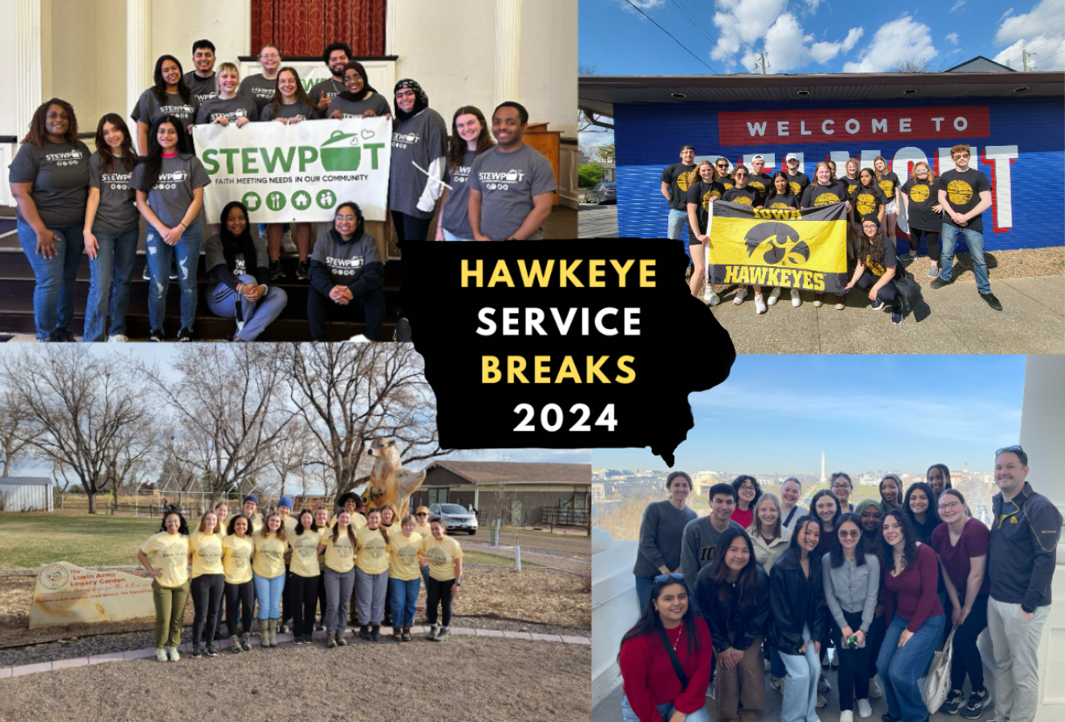
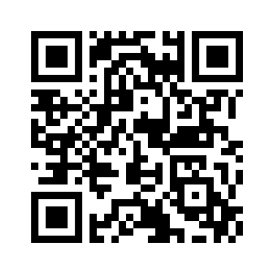
Leadership, Service, and Civic Engagement
The Leadership, Service, and Civic Engagement staff work to develop and foster leadership opportunities and civic engagement programs for students.
Key Programs and Initiatives
Hawkeye Service Breaks
Service and Community Engagement
Student Organization Support and Resources for over 600 organizations
Leadership Development
Check out Engage to see what organizations we have on campus

Slide 5
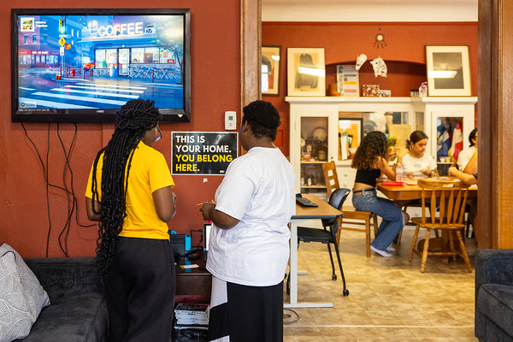
Multicultural and International Student Support and Engagement
Multicultural and International Student Support staff advise the campus cultural centers, that provide a home for multicultural programming, events, and activities open to all students at Iowa.
Cultural Centers include:
Afro-American Cultural Center
Asian Pacific American Cultural Center
Latino Native American Cultural Center
Pride Alliance Center

Slide 6
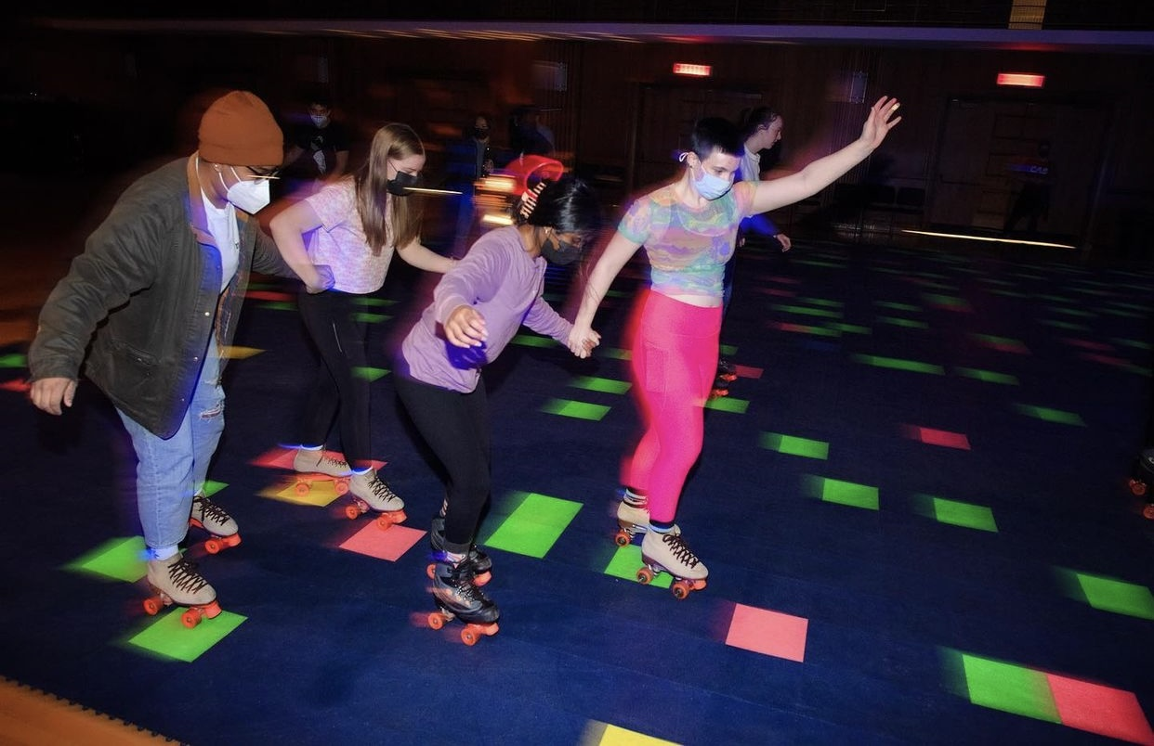
Student Engagement and Campus Programs
The Student Engagement and Campus Programs staff work to support student organizations and related activities that help to shape the student experience at Iowa.
Campus Life Organizations and Programs include:
Campus Activities Board
Dance Marathon
Homecoming Council
SCOPE Concert Productions
Bijou Film Board
Lecture Committee
Thursdays at the IMU
Notes:
Student Engagement & Campus Programs brings new experiences to campus each year and also continues brings back our favorite traditional events and making them better each time.
-Some of these include Bingo Nights, Roller Skating, Live Entertainment such as magicians and hosted by CAB, our annual Big Event hosted by the largest student organization on campus Dance Marathon, concerts hosted by SCOPE, movie showings by the Bijou Film Board, guest lectures such as Bill Nie the Science Guy and a week full of events hosted by the Homecoming Council.
-All of these organizations and programs are student lead and staff advised. So if you are looking for opportunities to develop your interest and enhance your experience and education inside and outside of the classroom, Student Engagement and Campus programs has plenty to offer.

Slide 7
Important Dates and Resources
Engaged Hawkeyes Week: August 25-September 3
Engagement Advising Pop-Up Meetings
MISSE Block Party
Thursdays at the IMU
Taste of Iowa City
Hancher Welcome Back Concert
Student Employment Fair
Student Engagement Fair
$4.00 Fridays at Chauncey Film Scene
Battle of the Bands
FSL Fun Fair
Engagement Advising
An engagement advisor can help explore and develop a student's interests. During the scheduled appointment they will focus on the student's path as a Hawkeye and create an action plan to achieve their goals.
Homecoming: September 21-27
Family Weekend: October 24-26

Slide 8
Text Questions to: (319) 853-8020
Notes:
At this time, I would like to invite our student panel and our facilitator __________ on stage for the parent panel.
(Panel Facilitator) Good morning. My name is __________. You can ask all your burning questions to our very knowledgeable Orientation Leaders. Please text the number on the screen (319) 853-8020 with any questions you have for our student staff. We will have them begin by introducing themselves and sharing their favorite memory from starting at Iowa:

Slide 9
Thank You!
Leadership and Engagement at the University of Iowa

