Slide 1
#HawkeyeSafe
SAFETY TIPS AND RESOURCES FOR COLLEGE LIFE
Notes:
Welcome attendees & introduce yourself
Years of service
Current Shift
Special assignments, if applicable

Slide 2
Campus Safety
Emergency Communications
Police Department
Security Services
Security Engineering
Emergency Management
Fire Safety
Threat Assessment
Clery Compliance
Notes:
Campus Safety Overview
Our 8 departments are listed above.
We will highlight three in more depth today.

Slide 3
Emergency Communications
Dispatchers answer 911 calls 24/7
Send appropriate first responders
Instruct callers on staying safe
319-335-5022
Notes:
Emergency Communications = Dispatch
We have our own dispatch center on campus, other agencies in the county share a dispatch center.
We have a team of around 9 dispatchers who,
Take calls
Dispatch appropriate first responders
Give callers instructions and connections to resources
Provide crucial information to keep people safe until help arrives

Slide 4
Police Department
42 State-sworn Police Officers
3 K-9 Officers
24/7/365 Patrol Coverage
Day Patrol
Night Patrol
Hospital Patrol
Enforces federal, state, and local, laws
Notes:
UIPD has 42 police officers
Respond to all the same types of calls as other agencies
Officers complete rigorous training, background investigations, and meet yearly benchmarks
3 K-9 Officers trained in
Weapons detection
Explosives detection
Person locating
Officers involved in
Johnson County Bomb Squad
Special Response Team
Detectives
Drug Task Force
Dive Team
Joint Forensic Analysis Cyber Team
Special focus and training on:
Community Outreach
Fair and Impartial Policing
Crisis Intervention Training
Active Shooter Response

Slide 5
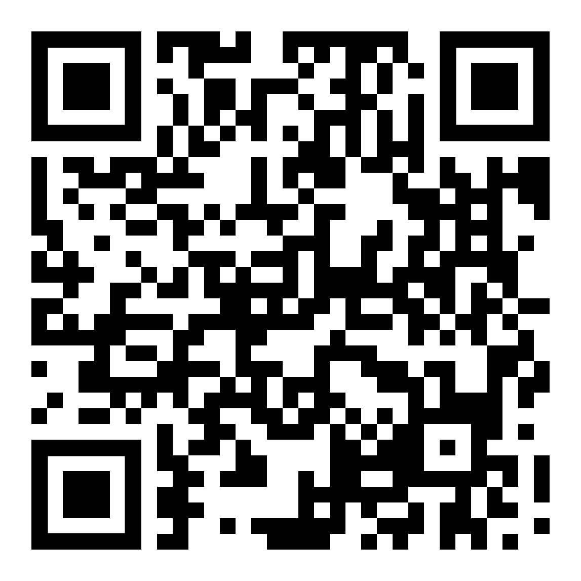
Security Services
Professional & Student Security
Nite Ride service
Patrol campus buildings
Identify safety issues
Sound Interesting?
Notes:
Main Functions
Nite ride service for students, faculty, and staff
Regular overnight patrols and monitoring cameras in and around campus buildings
Also operates campus Lost and Found and Fingerprinting
Student Security Opportunities
$13-$20/hour, minimum of 5 hours per week
Make your own schedule
Late and overnight hours
Duties include patrolling buildings, operating Nite Ride, and working special events
Use the QR code for more information on applying

Slide 6
HIGHLIGHTING COMMUNITY PARTNERS

Slide 7
Student Care Coordinators
Campus Partnership
Option for mental health concerns
Follow-up care for students who:
Had law enforcement contact
Used crisis intervention services
Experienced hospitalization
Need Basic Resources
Notes:
We have mental health advocates on campus that can assist students if they are experiencing a mental health crisis.
We do our best to handle these crisis at the lowest level before they become acute.
Helps students get set up with the right resources without involving police.
Department within the Dean of Students Office
3 full-time staff members
Therapy dog Wilkie
Great resource for those who need support in many areas
Sometimes the Student Care Coordinators assist on police calls

Slide 8
GuideLink Center
24/7 Service for individuals in crisis
Behavioral Health Crisis Stabilization
Evaluation and treatment for individuals with acute symptoms or distress
Sobering and Detoxification Service
Referrals to Resources
Notes:
Our county looks to treatment over incarceration when possible
Community initiated, and led by the Johnson County Board of Supervisors
Goal is to provide easier access to immediate onsite assessment and stabilization for those 18+ who are experiencing mental health or substance use crisis
Beds available for stays of up to 5 days
Open 24/7 because often crises don't happen during business hours
You can take Nite Ride to the GuideLink Center (with a friend)

Slide 9
Mobile Crisis Unit
Crisis Counselors:
Stabilize the crisis
Refer to resources
Reduce hospitalizations and arrests
Typically respond in less than 30 minutes.
Call 855–581–8111 or Text 988
Notes:
Mobile Crisis Response dispatches mental health counselors to where a mental health crisis is occurring. Anyone who is experiencing or is concerned about someone experiencing a mental health crisis can call.
Often, Mobile Crisis Unit assists on law enforcement calls where someone is in crisis and needs help and/or connection to community resources

Slide 10
FREE SAFETY SERVICES
Notes:
You might want to take your phones out, we have QR codes coming that will connect you to campus resources.

Slide 11
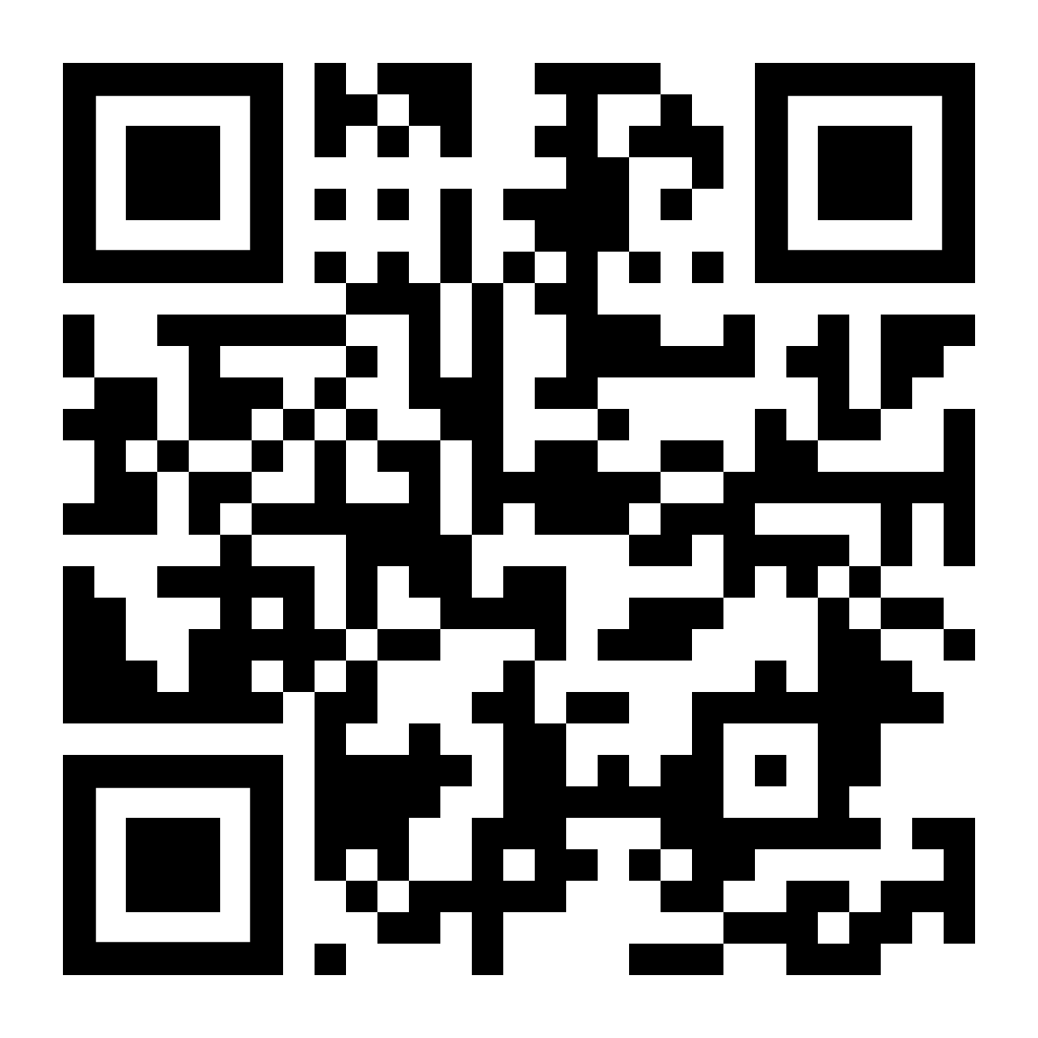
NITE RIDE
Free transportation service
10 p.m. to 5 a.m. daily
Driven by security officers
Express rides starting at $1/person
Notes:
Operated by professional and student security staff
Scan the QR code to learn more about how to use Nite Ride and the boundary map for Nite Ride
Price for express service increases with distance & number of people

Slide 12
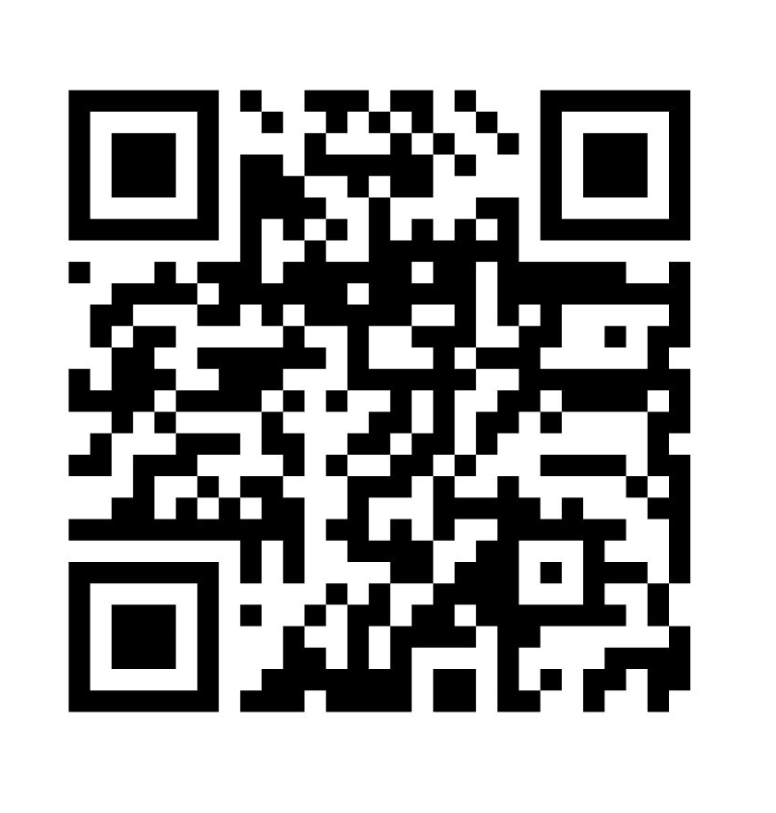
HAWK VOUCHERS
Five $5 Uber Vouchers
Made available to all students each semester
9 p.m. to 3 a.m.
3 mi radius of campus
Opt in at start of the semester
*While supplies last
Notes:
Operated by professional and student security staff
Scan the QR code to learn more about how to use Nite Ride and the boundary map for Nite Ride
Price for express service increases with distance & number of people

Slide 13
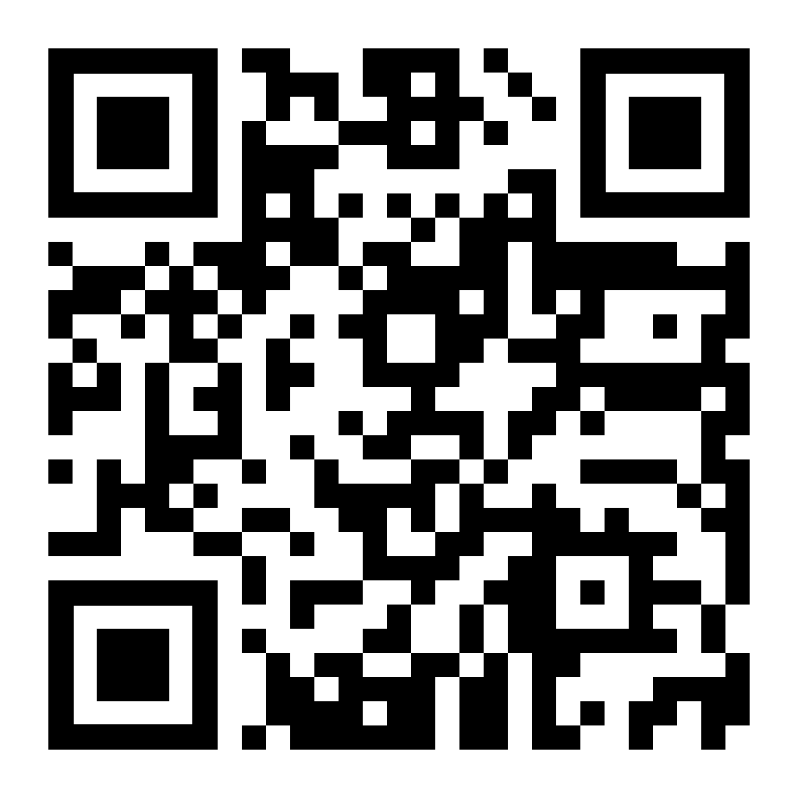
RAVE GUARDIAN
Free safety app
Safety timer for walk home
911 at the touch of a button
Text anonymous tips to police
Download the app!
Sign up with UI email
Notes:
Use the QR code to download the app where your student can utilize different resources to stay safe on campus
Your student can set you as their guardian, Campus Safety, or a friend/room mate

Slide 14
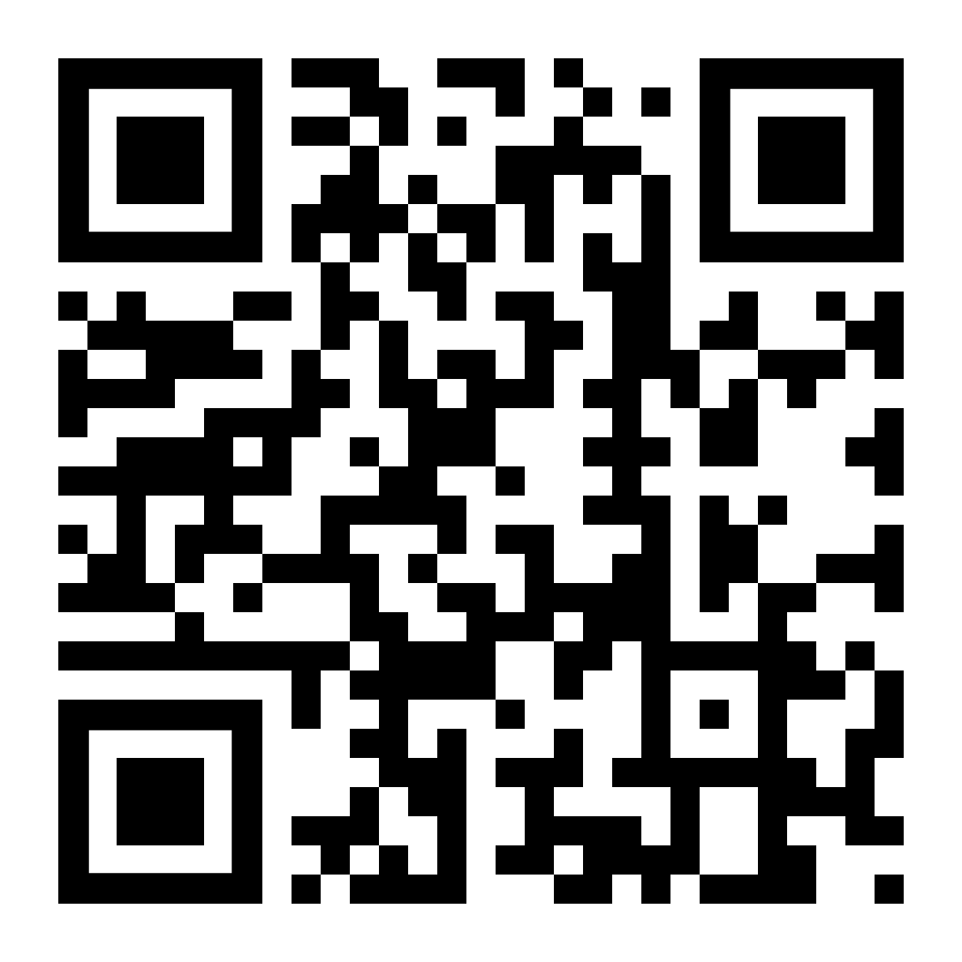
BIKE INDEX
Free bike registry
Creates a record of ownership
Helps us return it to you if it’s lost, stolen, or impounded
Register your bike!
Be a good "roll model"
Bike and scooter at a safe speed and be courteous and aware of pedestrians and vehicles
Review UI policies
Notes:
Registering your bike with Bike Index is free and voluntary. It creates a record of ownership, and may help us return it to you if it is stolen.

Slide 15
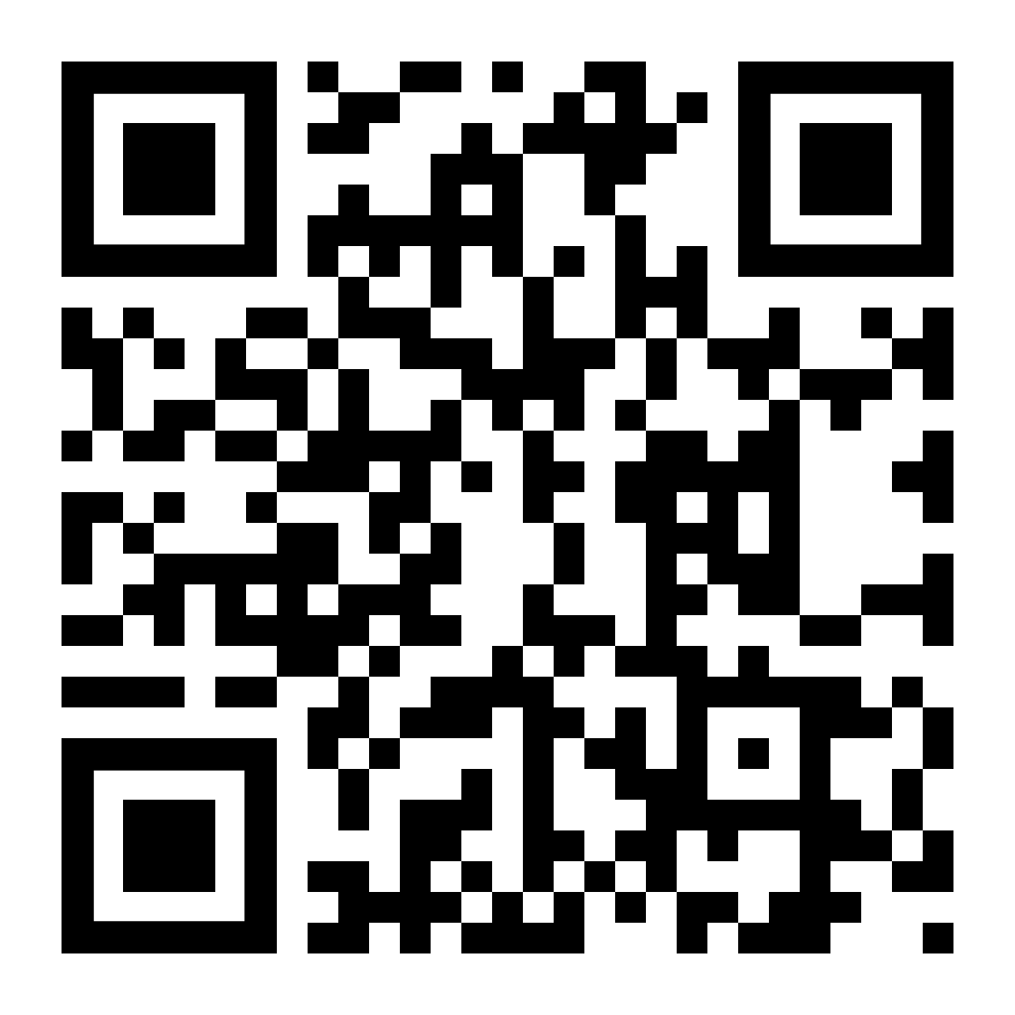
SAFETY TRAINING
We offer free and low-cost courses, including:
Civilian Response to Active Shooter Events
Rape Aggression Defense
Personal Safety and Self-Protection
CPR-BLS
Stop the Bleed
Notes:
We offer 11 total courses you can take to stay informed and prepared to stay safe and enjoy your Iowa experience!
The QR code will take you to a page where you can learn more about each course and how to sign up.

Slide 16
Lost and Found
139 University Capitol Centre
Turn in found items
Retrieve lost items
File a lost property report
Open weekdays 8 a.m. to 4 p.m.
Search the online database for found items on the Campus Safety website
Notes:
If you find something and want to turn it in, this is the place to do so. If it is outside business hours, you can submit found items in the police station lobby in the basement of the University Capitol Centre/Old Capitol Mall.
If you lose something, you can also submit a claim so we can contact you if your item is found.

Slide 17
EMERGENCY NOTIFICATIONS

Slide 18
HAWK ALERT
Ongoing immediate risk to campus safety
Threat information, how to stay safe
ONLY for students, faculty, and staff
Updates posted on:
EMERGENCY.UIOWA.EDU
Twitter (@uiowa_police)
Notes:
Hawk Alerts get sent out when there is something happening that could harm the university community
Examples from this spring include a tornado warning, a potentially violent individual, a gas line break, and the "all-clear" message when the situation stabilized
Students should review and update their Hawk Alert settings in MyUI. Make sure everything is current!
These alerts are only sent directly to people with a UI email (students, faculty, staff)
Hawk Alerts are focused on those on campus because sending to a wider audience can slow down the messaging for those on campus.
For everyone else, we post them on our website and Twitter/X account

Slide 19
CRIME ALERT
Incident already occurred but could be an ongoing threat
Specific safety tips
Emailed to students, faculty, and staff
Posted on our website:
SAFETY.UIOWA.EDU.
Notes:
These are for past incidents where widespread knowledge could increase safety within the University community
These are for Clery Crimes, including:
Murder
Manslaughter
Sex offenses
Robbery
Burglary
Aggravated assault
Arson
Motor vehicle theft
Domestic/dating violence
Stalking
Hate crimes
These alerts are only sent directly to people with a UI email (students, faculty, staff)

Slide 20
STAYING SAFE
Notes:
We've told you who we are, who we partner with, what we can offer you, but the most important part is next.
In this next section, let's talk about actions YOU can take to protect yourself and those around you.

Slide 21
SAFE IN YOUR NEW HOME
Lock your door
Do not hold locked doors open
Do not loan keys or Iowa One Card
Watch your belongings
Know who is at your door before opening
Notes:
Whether in a residence hall or an off-campus property, here are some steps your student can take.
A locked door is an extra layer of security that only works if the lock is engaged!
Holding open a secure door for someone coming in behind you could result in someone who does not belong getting access to residential areas.
Be mindful about leaving keys or Iowa One Card where someone else could access them, avoid giving either to someone else to use.
Watching their belongings is crucial, we receive theft reports of laundry left unattended, gym bags taken out of unlocked lockers. The more you keep an eye on your belongings, the less likely it can be taken without your knowledge
If someone is knocking at the door, trying to make a delivery, or gain access to their residence, use the peephole, look through a window, or ask who is there. If something seems 'off,' calling the police can help to document and/or diffuse the situation

Slide 22
DAILY SAFETY TIPS
Be aware of your surroundings
Be mindful of what you post online
Trust your instincts
If you see something, say something
Notes:
Day to day, being aware of what is around you can help you notice things that you might not if you are looking at your phone, listening to music, or not paying attention. Both from a safety perspective and exploring their new home, being open to what is around them can improve their experience.
As we will talk about in the next slide, the things your student posts online can be viewed fairly easily, and once it is out there, it is almost always permanently out there. People may try to use this to gain access to your student.
Most importantly, if your student sees something, have them say something to us, a professor, advisor, RA so we can take action.

Slide 23
SCAMS
College students are often targets
Educate yourself
Sextortion:
Online contact
Express strong emotions
Gather compromising images
Financial Domination
Threaten to share
DO NOT PAY
Report to police
Notes:
Tell your student, if for any reason, they are contacted by individual to extort money from them to call the police.
Every year, students are extorted financially because they did something in front of their camera of their laptop.
Now the other person is trying to get money.
Other reasons can be missing court, parking tickets, etc... Tell them to call UI Police first and we can help them before they lose any money.

Slide 24
TRANSPORTATION
Cars:
Insurance and registration
Spare key
Drive the car at least every other week
Remove valuables
Bikes:
Use a quality lock
Check it regularly
Make sure it’s registered
Notes:
CARS
Start and drive it at least biweekly or monthly
In Iowa you need to have your valid driver's license, registration, and proof of insurance in the vehicle. Insurance can be pulled up on your phone.
Keep valuables out of your car, or not visible to passersby so there is less of a temptation for someone to burglarize the vehicle
Lock your doors, a locked door may be enough of a deterrent for someone looking for an easy target
You’d hate to be getting ready to leave for break and discover your battery is dead, you have a flat tire, or it’s been damaged
Call UI Police and we can help
BIKES
If you plan to bring a bike to campus, make sure it’s registered using Bike Index (bikeindex.org/uiowa).
This helps us return your property to you if it is lost, stolen, or impounded.
Take your bike home at Thanksgiving Break. Check on it daily when it is on campus.
Use a good bike lock, and an airtag. A $10 lock on a $1000 bike may not be a wise choice.

Slide 25
Sexual Assault
Iowa Code - 709
*We will discuss sexual assault during this portion of the presentation
Notes:
We will discuss the issue of sexual assault during this portion of the presentation. Please feel free to leave the room if this is a sensitive topic for you.

Slide 26
SEXUAL ASSAULT
A Sexual Assault is a sex act. A sex act is against a person’s will if CONSENT is attained by threats of violence, if they are asleep, unconscious, or incapacitated due to drugs or alcohol or any other reason, or if the person has a disability that limits their ability to make decisions in sexual matters…
Notes:
Read this verbatim, included here:
709.1 Sexual abuse defined. Any sex act between persons is sexual abuse by either of the persons when the act is performed with the other person in any of the following circumstances:
1. The act is done by force or against the will of the other. If the consent or acquiescence of the other is procured by threats of violence toward any person or if the act is done while the other is under the influence of a drug inducing sleep or is otherwise in a state of unconsciousness, the act is done against the will of the other.
2. Such other person is suffering from a mental defect or incapacity which precludes giving consent, or lacks the mental capacity to know the right and wrong of conduct in sexual matters.
3. Such other person is a child
702.17 Sex act. The term “sex act” or “sexual activity” means any sexual contact between two or more persons by any of the following: 1. Penetration of the penis into the vagina or anus. 2. Contact between the mouth and genitalia or mouth and anus or by contact between the genitalia of one person and the genitalia or anus of another person. 3. Contact between the finger, hand, or other body part of one person and the genitalia or anus of another person, except in the course of examination or treatment by a person licensed pursuant to chapter 148, 148C, 151, or 152. 4. Ejaculation onto the person of another. 5. By use of artificial sexual organs or substitutes therefor in contact with the genitalia or anus. 6. The touching of a person’s own genitals or anus with a finger, hand, or artificial sexual organ or other similar device at the direction of another person.
Is a sex act is against a person’s will if CONSENT is attained by threats of violence, if they are asleep, unconscious, or incapacitated due to drugs or alcohol or any other reason, or if the person has a disability that limits their ability to make decisions in sexual matters…if the other person is a child.
IF ASKED: It is important to clarify that simply having alcohol in your system does not mean you are incapacitated. Intoxication and incapacitation are not the same thing.
709.1A Incapacitation. As used in this chapter, “incapacitated” means a person is disabled or deprived of ability, as follows: 1. “Mentally incapacitated” means that a person is temporarily incapable of apprising or controlling the person’s own conduct due to the influence of a narcotic, anesthetic, or intoxicating substance. 2. “Physically helpless” means that a person is unable to communicate an unwillingness to act because the person is unconscious, asleep, or is otherwise physically limited. 3. “Physically incapacitated” means that a person has a bodily impairment or handicap that substantially limits the person’s ability to resist or flee.

Slide 27
CONSENT
Consensual sex occurs when both partners agree to engage in sexual activity
ALWAYS knowing, ongoing, and voluntary
A person cannot consent if they are asleep, unconscious, or incapacitated due to drugs/alcohol
Notes:
We have a video on our website that breaks down the concept of consent. We encourage you to have a conversation with your student about this prior to their arrival on campus.

Slide 28
SEXUAL ASSAULT
Present on all college campuses
Only 5% are reported
8 in 10 incidents are committed by an acquaintance
Most sexual assaults involve alcohol
Source: Rape Abuse and Incest National Network (RAINN)
Notes:
In order to lessen the trauma that comes from retelling, and reliving what happened, if the assault occurred on university property, the report would be taken by UI Police or UI staff. If the report is in Iowa City, Coralville, North Liberty, or another city and off of University of Iowa property, the local jurisdiction would take the report.
When someone contacts law enforcement to report a sexual assault, we want to give the survivor options and control of what happens next.
No report
Make a report, documentation only
Make a report, file charges, and open an investigation
When someone reports to law enforcement, we can connect the survivor with an advocate, a confidential resource to help the survivor navigate the options.
RVAP – the Rape Victim Advocacy Program will soon be operated by DVIP. These services will continue to be available to students on campus.

Slide 29
SEXUAL ASSAULT
Sexual assault is never the fault of the survivor
Risk reduction techniques include:​
Know what you drink​
Trust your instincts
Use the buddy system​
Be assertive​
Avoid mixing sex and alcohol
Notes:
The only way to truly stop sexual assault is for the perpetrator to decide not to commit the act.
We have a video on our website that breaks down the concept of consent. We encourage you to have a conversation with your student about this prior to their arrival on campus. It is important they understand consent and respecting people’s boundaries.
Some of these are tips we've already covered, but these are important to staying safe, while acknowledging the only person to blame for a sexual assault is the person who commits the assault.

Slide 30
BYSTANDER INTERVENTION
Trust your instincts
Disrupt the chain of events
Create a distraction and involve others
Ensure everyone has a safe way home
Being an active bystander does not require you to put yourself at risk
Notes:
Bystander intervention does not have to put you in harms way, but puts you in a place to connect to resources and get appropriate help and support to stay safe.

Slide 31
SEXUAL ASSAULT RESOURCES
Victim Advocates
Counseling
Domestic Violence and Sexual Assault Crisis Services (DVIP & RVAP) DVIP: (800) 373-1043 (24-hour hotline) RVAP: (800) 228-1625 (24-hour hotline)
Monsoon Asians & Pacific Islanders in Solidarity (866) 881-4641 (24-hour hotline)
Nisaa African Family Services (319) 338-7617
Transformative Healing (319) 389-8430
University Counseling Service (for students) (319) 335-7294
Women's Resource and Action Center (319) 335-1486
• DomesticViolence and Sexual Assault Crisis Services (DVIP & RVAP) DVIP: (800) 373-1043 (24-hour hotline) RVAP: (800) 228-1625 (24-hour hotline)
UI 24/7 Support and Crisis Line (844) 461-5420
Notes:
RVAP will soon be managed by DVIP. That transition will take place this fall, but advocate resources will continue to be available for UI students.

Slide 32
SAFETY RESOURCES
Reporting Crimes and Concerns
Where to find safety information
Emergency:
Call 911
Non-emergency, on-campus:
University of Iowa Police Department
319-335-5022
Suspicious or troubling behaviors:
Threat Assessment Team
319-384-2955; uitat@uiowa.edu
Non-emergency, off-campus:
Iowa City Police Department
319-356-5275
Campus Safety information, news, and tips:
SAFETY.UIOWA.EDU
Emergency Updates:
EMERGENCY.UIOWA.EDU
Facebook/Instagram:
Office of Campus Safety
@uiowa_safety
X: @uiowa_safety
Notes:
If an incident happens off campus, your student should report it to their local law enforcement agency (location of the incident).

Slide 33
COMMUNITY OUTREACH
We are here to help you!
Safety training & presentations
Community events
Crime Prevention through Environmental Design
Officer Alton Poole
Community Outreach Specialist
Alton-Poole@uiowa.edu
Notes:
Officer Alton Poole is our Community Outreach Specialist.
Officer Poole cultivates and maintains relationships on campus and in the community and focuses on providing training, supporting campus and community initiatives, and doing so as a sworn law enforcement officer.

Slide 34
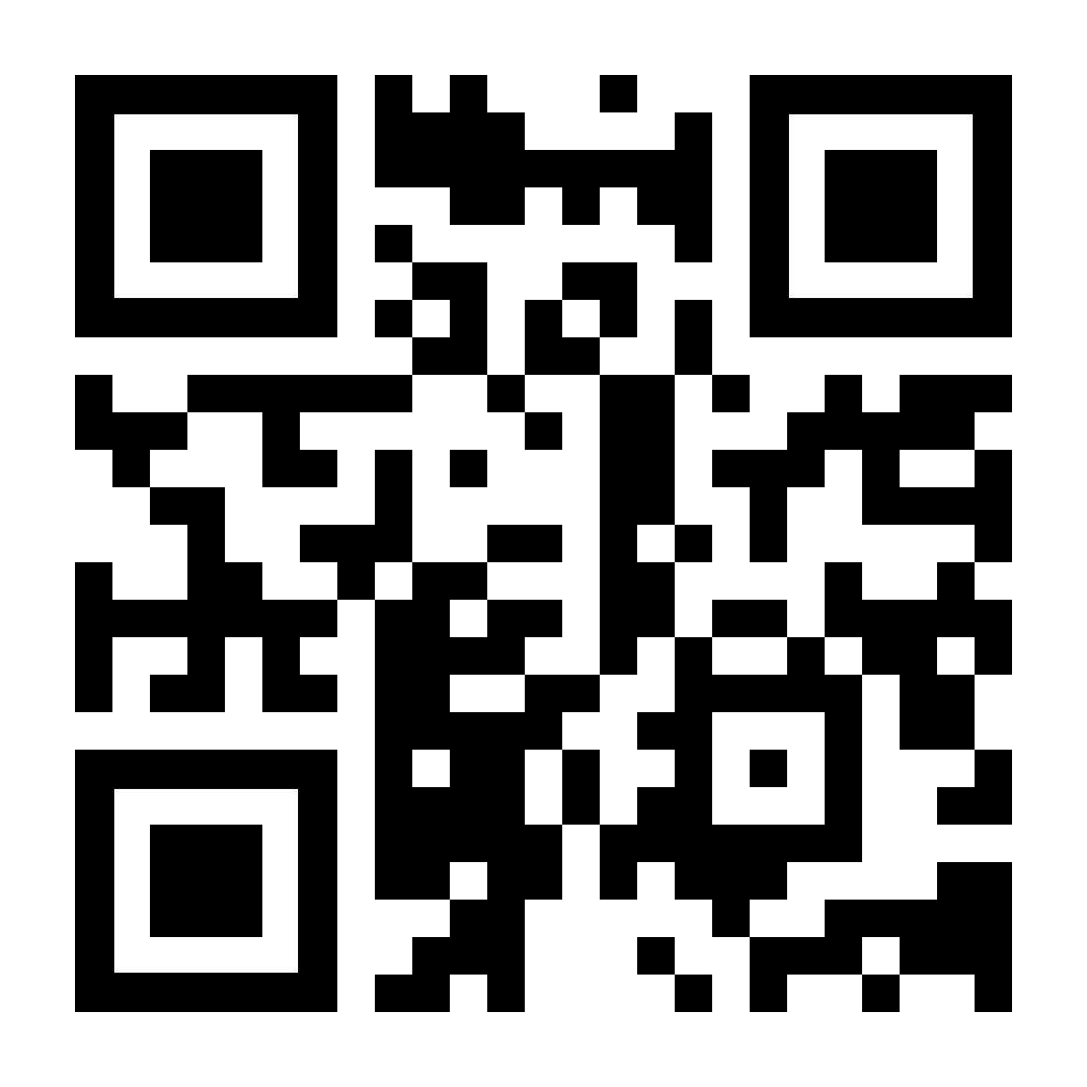
Questions?
Community Outreach Team
University of Iowa Police
319-335-5022
safety.uiowa.edu

