Slide 1
Ask an Orientation Leader!
Hosted by Orientation Services
Notes:
Welcome to Ask an Orientation Leader led by Orientation Services!

Slide 2
Exec Team

Slide 3
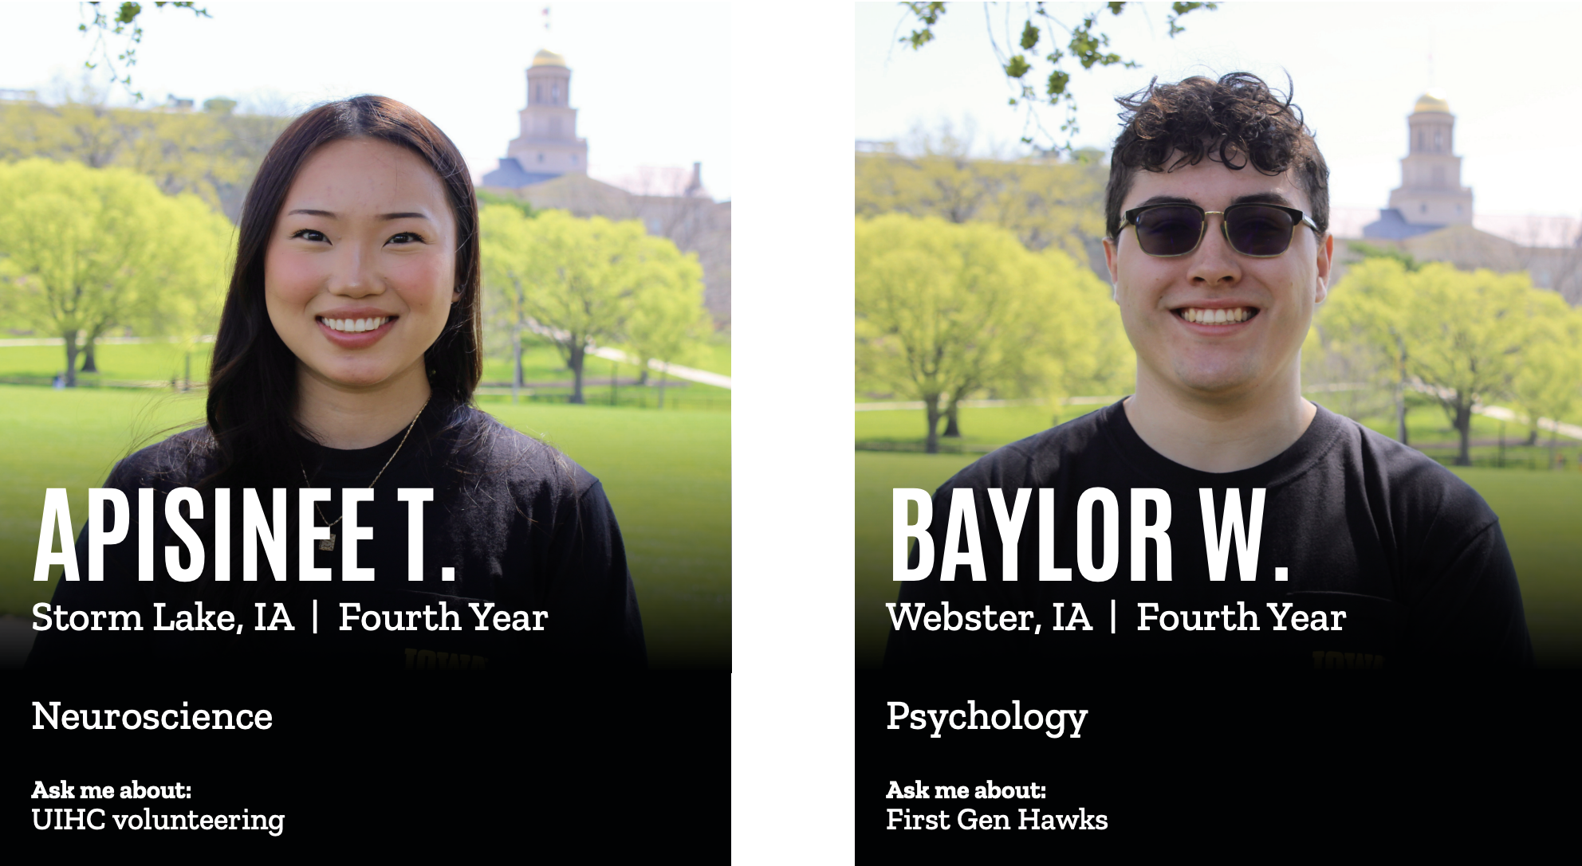
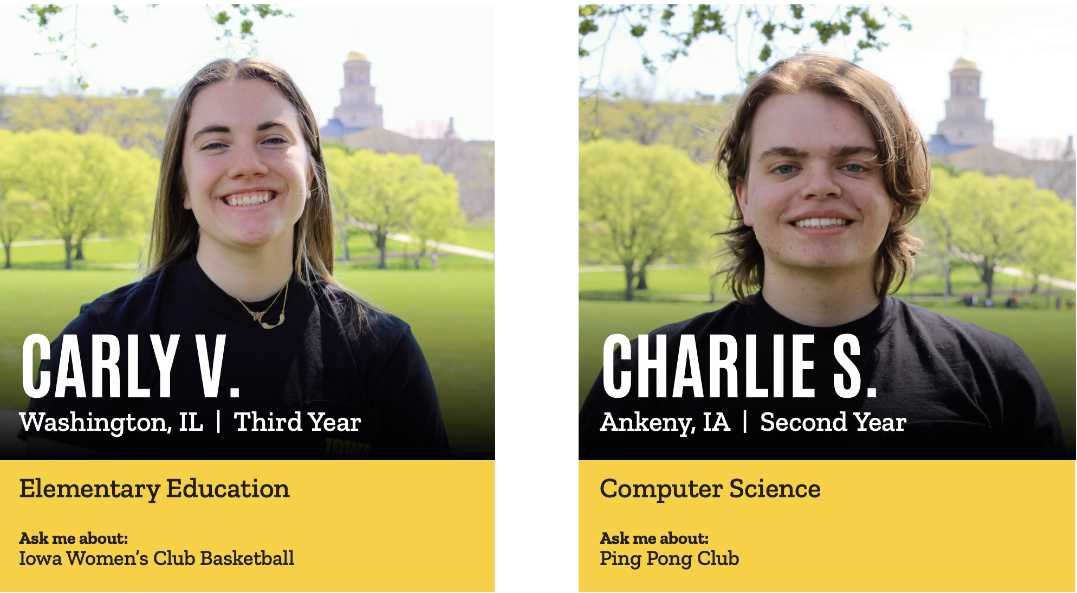
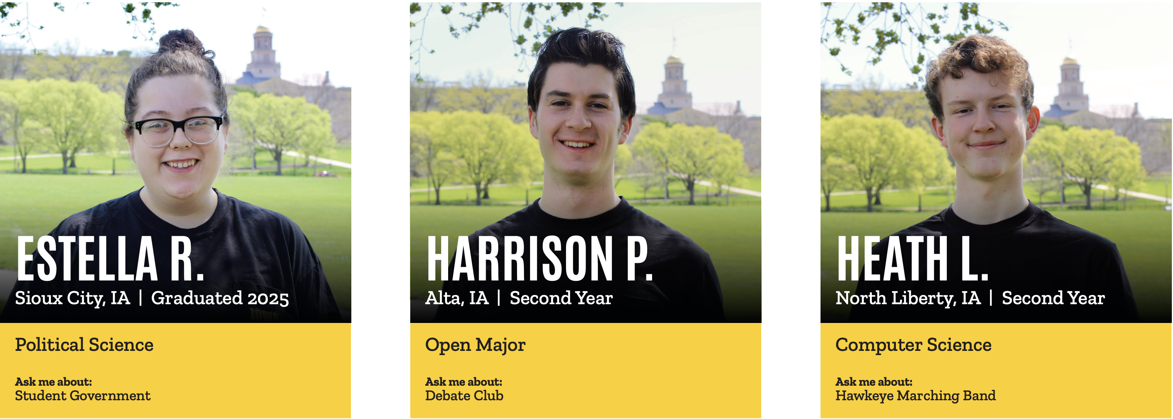
Orientation Leaders Pt. 1

Slide 4
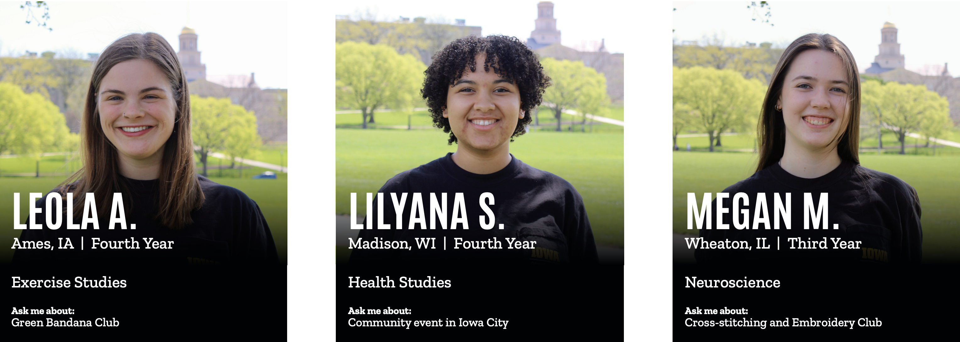
Orientation Leaders Pt. 2

Slide 5
Overview
Student Afternoon Experience
One Thing from an OL
Q&A
Notes:
We know that you are joining us this afternoon because you may still have questions about the student experience at Iowa – and we are here to help provide you with some answers! We also know that you may be curious about what your student is doing this afternoon so we want to provide you with an overview of what they are experiencing in their small groups.
First, we’ll start with an overview of the afternoon from the student experience. We will provide you with an outline of what they are doing and what resources the OL’s are providing them. Then, each of us will share out briefly the one thing we are passionate about here at the University of Iowa and why we feel like it is important for a student to know about. Then we’ll save plenty of time at the end for you all to ask us more of your questions.

Slide 6
Student Afternoon Schedule
Lunch in Catlett Marketplace
Ice Breakers
Small Group Presentation
Student Panel
Signing Herky at the IMU
Notes:
In your words, describe what the student is doing. For example, share what buildings the student may be seeing on their tour, or an ice breaker that you would do with them, or talk about how they may be spread across campus in various spaces that may correlate to their major. If you talk about the classroom spaces, be specific and say something like “For example, your Engineering student may be in the Seamen Center this afternoon experiencing their small group and having the first taste of what it is like to be in an actual classroom on campus.”

Slide 7
Small Group Session
Preparing for Your First Semester
Campus Resources
Getting Involved on Campus
Academic Success
Important information about obtaining a degree
Essential vocabulary to know
Overview of important UI systems
Preparing for daily routines
Exploring campus resources
Discussing where to go for various needs
Focus on finding community on campus
Making a plan to get involved

Slide 8
Your student is hearing about…
Exciting & challenging components to the transition
Engagement advising
MyUI schedule & ICON
University of Iowa student apps
Academic resources
And many other things!
Notes:
You’ll summarize one more time all of the things that students are hearing and interacting with:
Make sure to point out how much time students will use MyUI and ICON in their small group sessions.
You can ask the OL’s to share the academic resource that they would reference.

Slide 9
One thing from an OL!
OL’s share their expertise!
Notes:
On this slide, you and the OL’s will do another 1-minute presentation like we did in class. Instead of picking an organization, the OL should share the thing that is listed on their Kendall Gallery document. You don’t actually need to time it!

Slide 10
Q & A – Ask Away!
Notes:
Here is when the Q&A portion will happen – if there are no questions, you can use the documents provided.

