Slide 1
Welcome to the University of Iowa!
BECOMING A HAWKEYE
Summer 2025

Slide 2
STUDENT LIFE AT IOWA
Help navigate a new environment
Encourage involvement in activities and organizations
Promote civic engagement
Empower and encourage holistic well-being
Connect you to options to address challenges

Slide 3
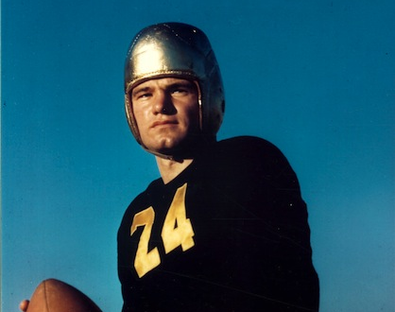
“It is my belief that the essential thing to be gained from a college education is to learn to think, to think for yourself; to develop an active, alert, inquiring mind...In reality you have to educate yourself. College only presents the opportunity.”
-NILE KINNICK

Slide 4
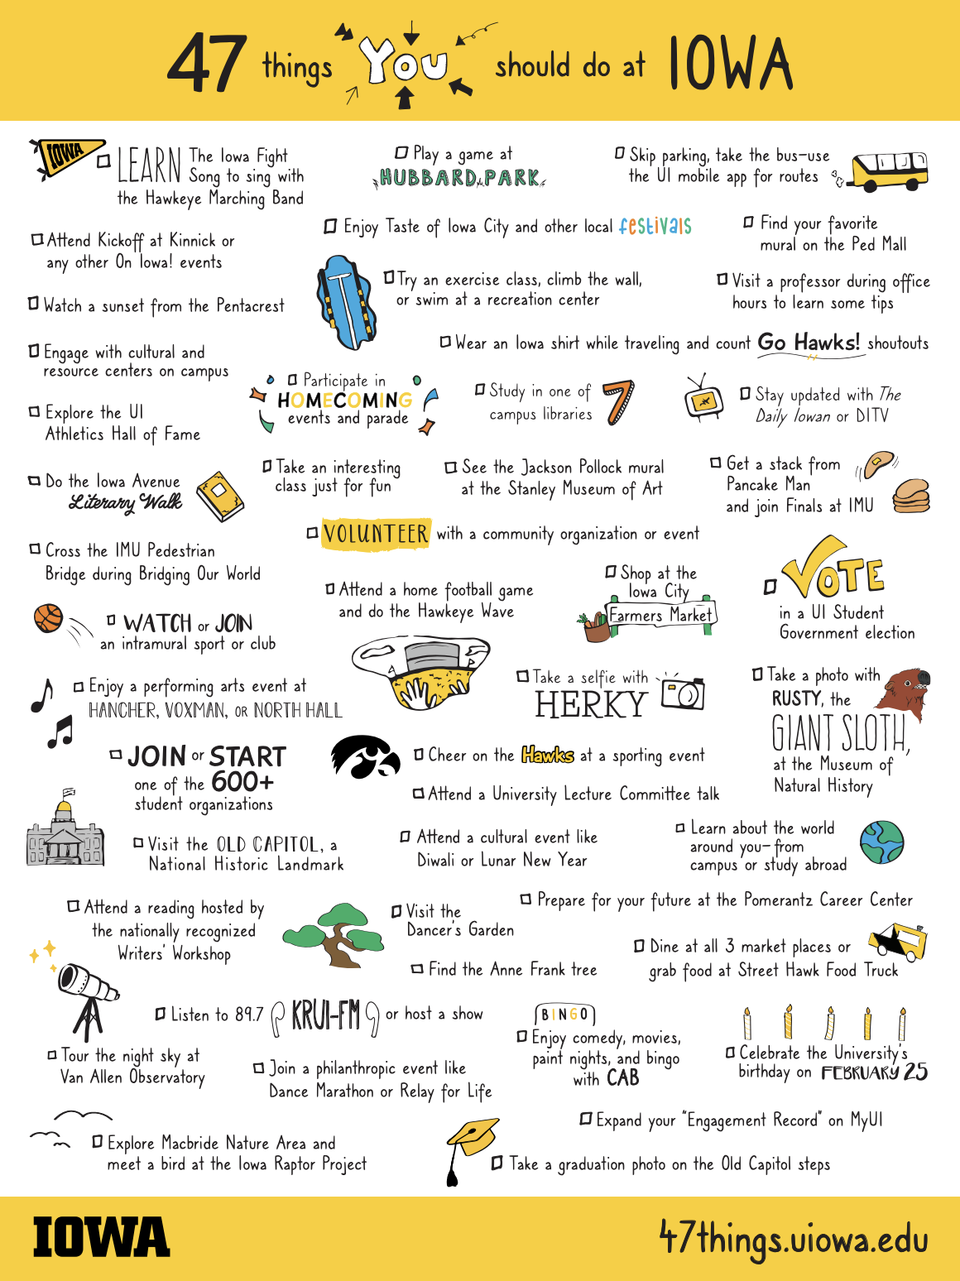
47 THINGS YOU SHOULD DO AT IOWA
Iowa encourages all students to participate in activities, undergraduate research, or join a student organization
Thousands of events and experiences exist at Iowa - this list includes campus traditions and things you don’t want to miss

Slide 5
ASK FOR HELP – WE ARE HERE FOR YOU!
Iowa is committed to well-being in all aspects of campus culture
A variety of supports and resources are available to help students thrive
Connect with faculty and staff
Reach out when you have a question or need assistance

Slide 6
MALIKA KARIMI
Human Physiology
Iowa City, Iowa
University Honors Program
President, DeGowin Blood Center Student Organization
Recipient, Hancher-Finkbine Medallion
Phi Beta Kappa
“It is important to first recognize your values and what you desire out of your undergraduate degree. If you engage in opportunities you find most enjoyable and fulfilling, you will be proud of what you accomplished by graduation day.”

Slide 7
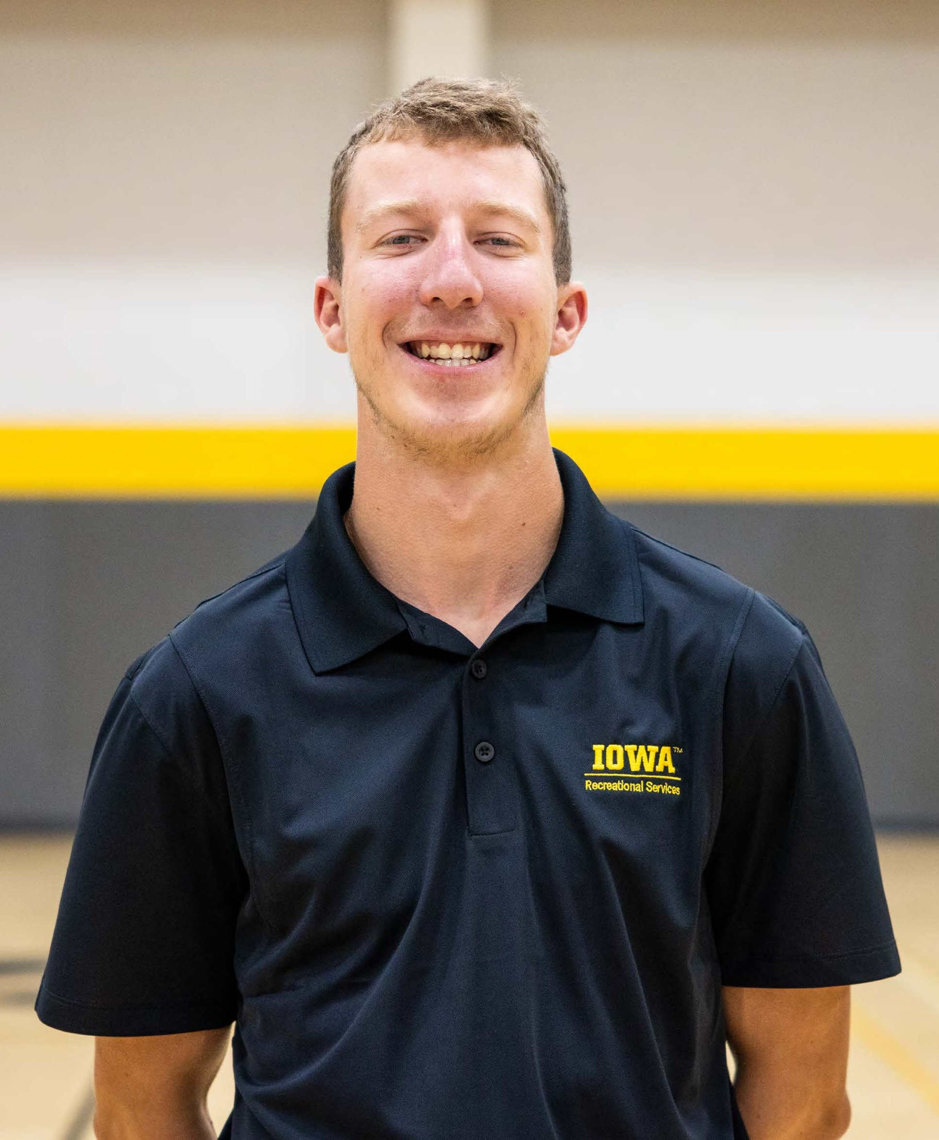
Alex Tuttle
Sports and Recreation Management
DeWitt, Iowa
Official of the Year, Intramural Sports
National Intramural and Recreation Sports Association (NIRSA), State of Iowa Student Leader
Member, Recreational Services Student Leadership Committee
“Take advantage of any and every opportunity that comes your way. You never know what you will learn or who you will meet from any given experience. The more you get involved on campus, the easier it is to figure out what you enjoy and what your path is.”

Slide 8
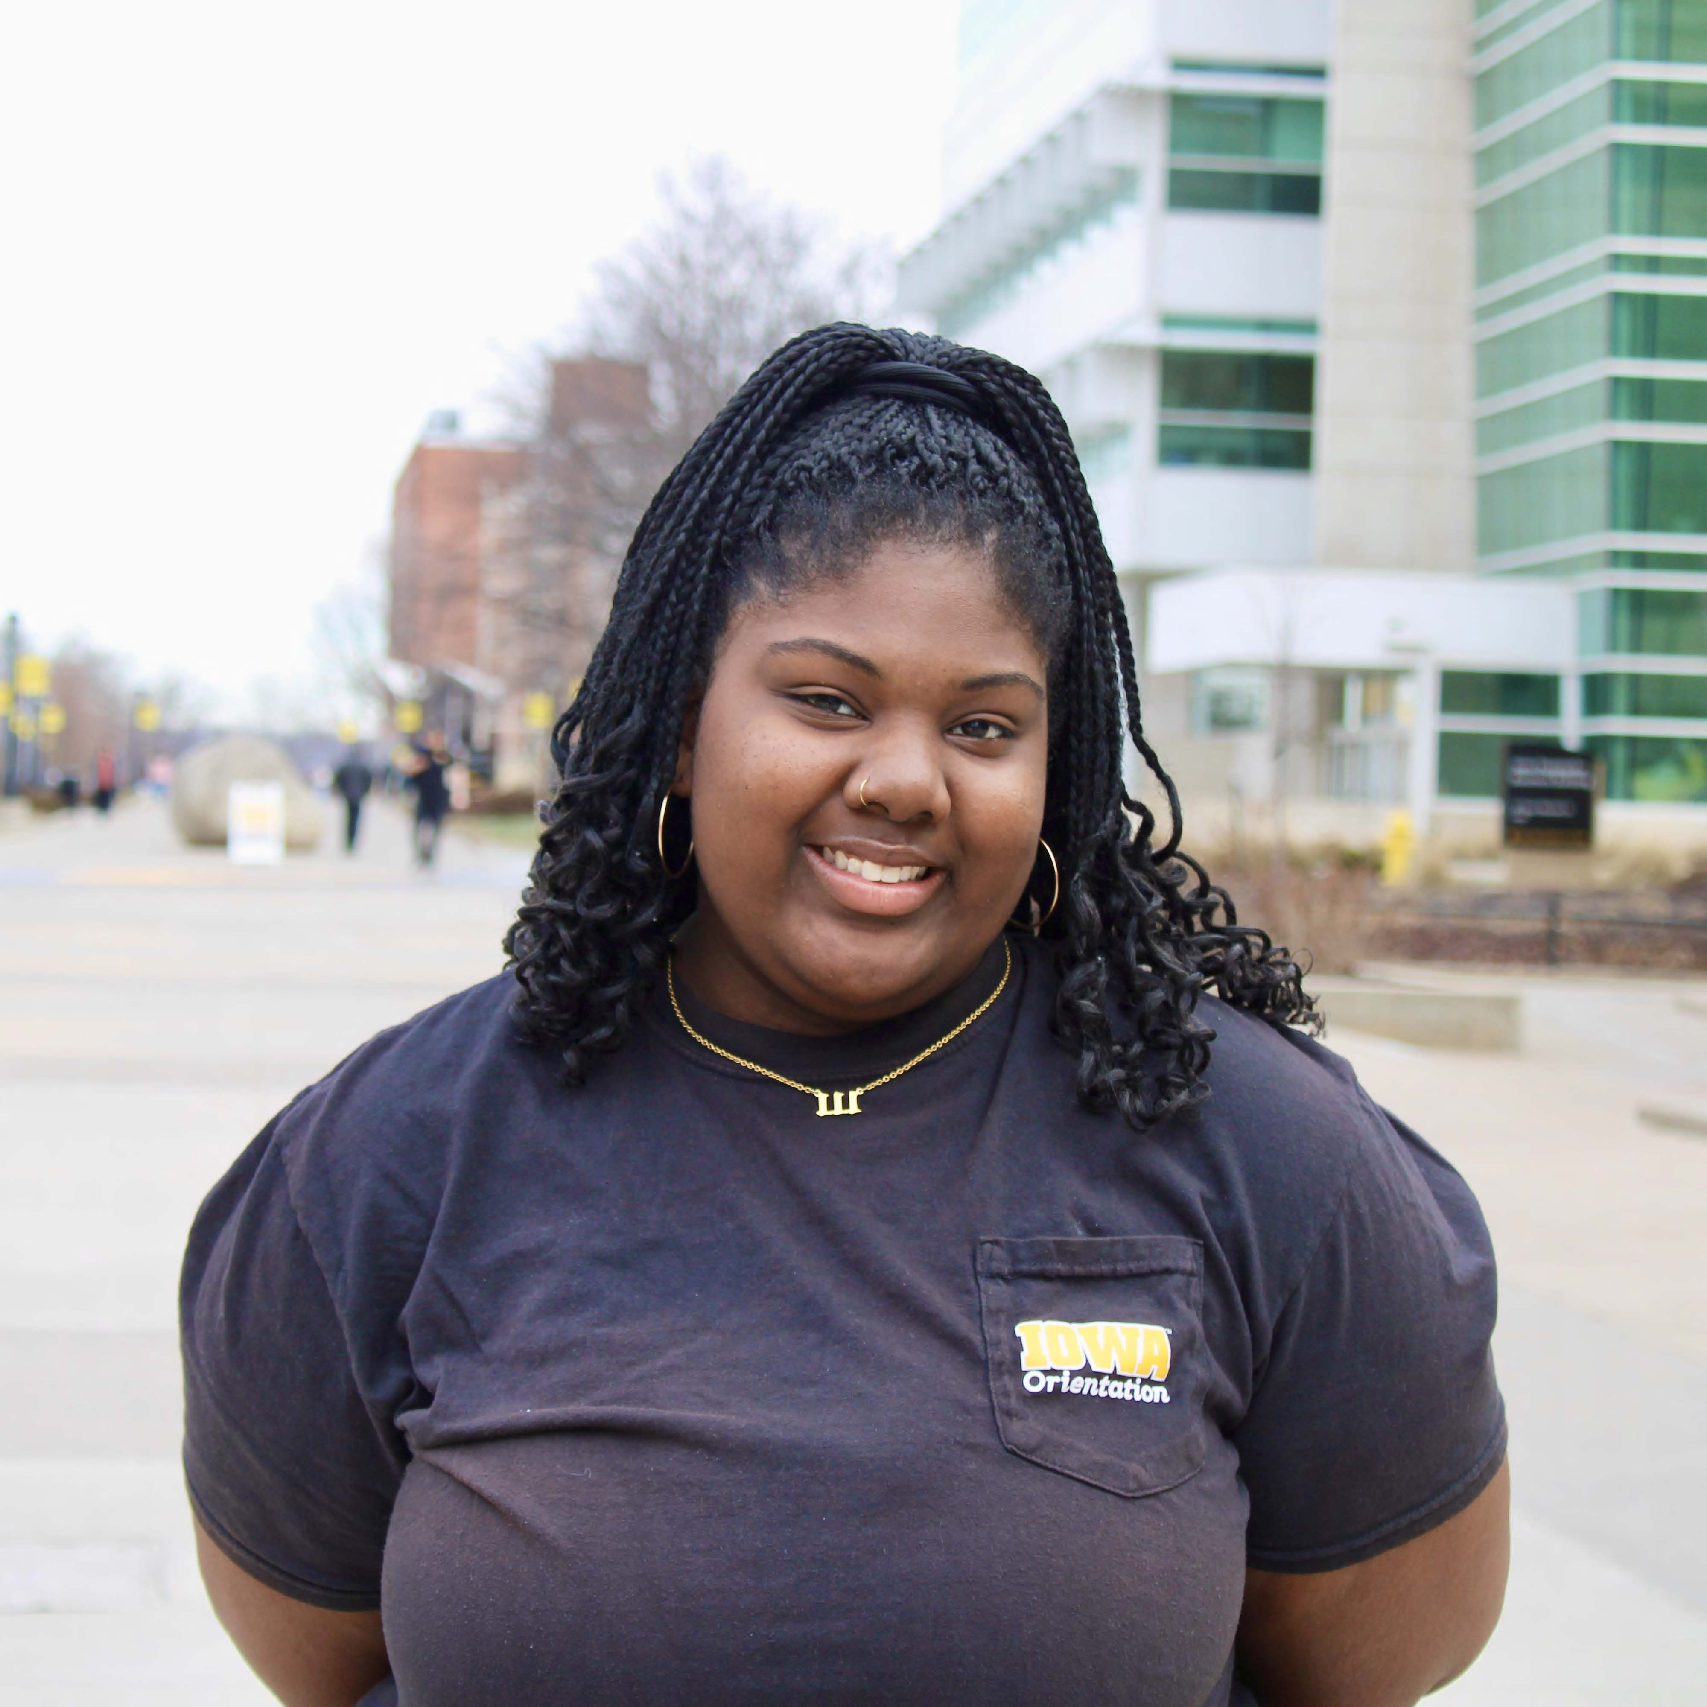
Kay Haslam
Criminology, Law, and Justice
Davenport, Iowa
Marketing Director, Campus Activities Board
Executive Leader, Orientation
Resident Assistant
Member, University Housing and Dining Advisory Board
“Leadership is about adaptability and trust. At Iowa, I discovered being a leader isn’t always about taking charge but trusting others and empowering them. Listening, being flexible, and fostering a welcoming environment are key to creating meaningful change.”

